Slide 1
B-13 – Law and Policy Implications for Supporting Students with Disabilities
Lead Presenters:
Mitchell Yell, PhD
University of South Carolina
&
Laura Kern, JD, PhD
University of South Florida
Key Words: Behavior, Disabilities, Special Education

Slide 2
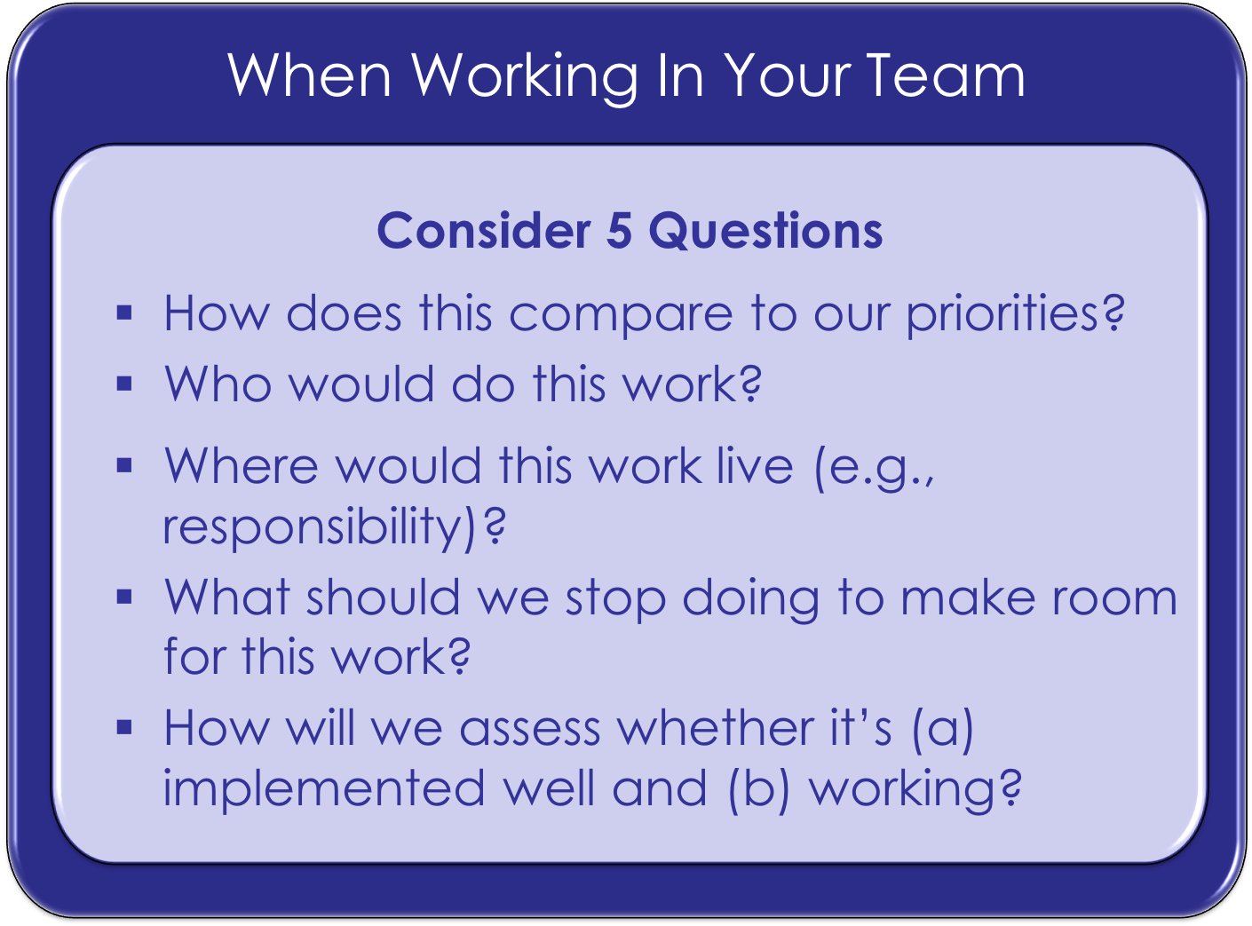

Slide 3
Objectives
Become familiar with federal law and guidelines for serving students with disabilities within a School-wide PBS framework
Understand how court case precedent may impact SW-PBS and students with challenging behaviors
Discuss the impact of Endrew F. for students with disabilities and behavioral challenges
Share suggestions for lawmakers and IEP teams

Slide 4
Early Intervention
PBIS
MTSS
RTI
ESSA
IDEA

Slide 5
Every Student Succeeds Act of 2015 (ESSA)
Allows LEAs to use federal monies to support PBS and multi-tiered systems of support (MTSS)
Does not require that LEAs implement PBS or MTSS systems, but gives SEAs & LEAs great flexibility to use such systems
Recognizes that student learning is directly affected by school climate and the supports and services to all students

Slide 6
ESSA
Professional Development
Gives teachers and principals the knowledge and skills to provide instruction and academics support services, to those children, including positive behavioral interventions and supports, multi-tier system of supports…
Use of Funds
An LEA that “receives a subgrant under section 2102 shall use the funds made available through the subgrant to develop, implement, and evaluate comprehensive programs and activities…which may include the use of multi-tier system of supports and positive behavioral interventions and supports…”
MTSS
Defined
Comprehensive continuum of evidence-based, systemic practices to support a rapid response to students’ needs, with regular observation to facilitate data-based instructional decision making

Slide 7
ESSA
Activities to Support Safe and Healthy Students
May include schoolwide positive behavioral interventions and supports, including through coordination with similar activities carried out under the Individuals with Disabilities Education Act, to improve academic outcomes and school conditions for student learning
Targeted Assistance
May include “a schoolwide tiered model to prevent and address behavior problems, and early intervening services, coordinated with similar activities and services carried out under the Individuals with Disabilities Education Act…

Slide 8
The Individuals with Disabilities Education Act
Whole-school approaches
Positive behavioral interventions and supports
Scientifically based early reading programs
Early intervening services
Research suggests
  reduces the need to label children to address their learning and behavioral needs

Slide 9
Early Intervening Services
Allow or require use of Part B funds
Quickly and effectively addresses problems and/or decreases severity
(IDEA, 20 U.S.C. § 1413(f))

Slide 10
Early Intervening Services:
Advantages
Emphasizing research-based practices in intervention
Focusing on student outcomes rather than services received
Identifying students early in their school careers using a risk rather than a deficit model

Slide 11
Early Intervening Services:
Core Characteristics
Continuous monitoring of student performance
Multiple levels (tiers) of instruction that are progressively more intense, based on the student’s response to instruction
All students are screened for academic and behavioral problems
High quality research-based instruction in their general education setting
Questions and Answers on RTI and EIS (U.S. Department of Education, 2007)

Slide 12
PBIS & IDEA
Using PBIS for behavior
IEP teams “consider the use of positive behavioral interventions and supports for any student whose behavior impedes his or her learning or the learning of others
Training in PBIS
State Educational Agencies are authorized to “provide training in the methods…positive behavioral interventions and supports to improve student behavior in the classroom”
(IDEA, 20 U.S.C. § 1414(d)(3)(b)(i); IDEA, 20 U.S.C. §1454(a)(3)(B)(iii)(I))

Slide 13
OSERS & OSEP Dear Colleague Letter Subject: “PBIS in IEPs”
“As a matter of best practice, we strongly encourage schools to consider how the implementation of behavioral supports within the IEP could be facilitated through a school-wide, multi-tiered behavioral framework.”
https://www2.ed.gov/policy/gen/guid/school-discipline/files/dcl-on-pbis-in-ieps--08-01-2016.pdf

Slide 14
OSERS & OSEP Dear Colleague Letter Subject: “PBIS in IEPs”
Research shows that
school-wide, small group, and individual behavioral supports that use proactive and preventative approaches
address the underlying cause of behavior, and
reinforce positive behaviors are associated with increases in academic engagement, academic achievement, and fewer suspensions and dropouts
Student achievement supported when
directly taught predictable and contextually relevant school and classroom routines and expectations
acknowledged clearly and consistently for displaying positive academic and social behavior
consistently prompted and corrected when behavior does not meet expectations
treated by others with respect

Slide 15
OSERS & OSEP Dear Colleague Letter Subject: “PBIS in IEPs”
Behavioral supports are most effectively organized within a multi-tiered behavioral framework
that provides instruction and clear behavioral expectations for all children,
targeted intervention for small groups not experiencing success, and
individualized supports and services for those needing the most intensive support (p.8)
IEPs should contain
Behavioral supports supported by evidence
Based on peer-reviewed research to the extent practicable

Slide 16
RTI & IDEA
A State must adopt…criteria for determining whether a child has a specific learning disability (SLD)
Must not require the use of a severe discrepancy between intellectual ability and achievement
Must permit the use of a process based on the child’s response to scientific, research-based intervention

Slide 17
OSEP Memorandum of 1/21/11
Issued to State Directors of Special Education
From: Melody Musgrove, Director of OSEP
Subject: “A response to intervention (RTI) process cannot be used to delay-deny an evaluation under the IDEA”
https://www2.ed.gov/policy/speced/guid/idea/memosdcltrs/osep11-07rtimemo.pdf

Slide 18
MTSS/RTI and Students with Disabilities
Support
&
Inform
Part of the child find process
Accurate Referrals
Ensures that only students who need special education services receive those services
Appropriate Services
For those students who struggle academically and behaviorally, but are not students under IDEA, services can be provided in general education

Slide 19
RTI
RTI/MTSS was designed to slow down referrals to special education by school personnel by solving student problems before a student needs special education
Child Find
When school district personnel have a reason to suspect that:
A student may have a disability, and
May need special education services
Public school districts must have a process for identifying, locating, and evaluating children and youth from ages birth through age 21, who may need special education (34 C.F.R. § 300.111(a)(i))

Slide 20
Inappropriate
Using RTI to delay and deny students’ evaluation for special education
Violating child find and evaluation mandates of the IDEA
Not allowing a parent to request an initial evaluation at any time to determine if a child is a child with a disability

Slide 21
Appropriate
Conducting a special education evaluation, providing notice of procedural safeguards and obtaining consent to for the evaluation
Following child find and evaluation mandates of the IDEA
Not conducting an evaluation, providing notice of procedural safeguards and prior written notice describing the reasons why an evaluation was not needed

Slide 22
WHAT’S THE MESSAGE?
If a school uses an RTI/PBIS/MTSS system and a student’s parents request an evaluation, may school personnel tell the parents we need to go through the RTI/MTSS system prior to considering a referral?
NO!!!!

Slide 23

The Elephant in the Room

Slide 24
If a school uses an RTI/PBIS/MTSS system when should school personnel refer a student for special education evaluation?

Slide 25
Letter to Ferrara (2012)
Background
“School districts are requiring that the RTI process must be completed before a referral for an initial evaluation can take place.”
“some districts are not providing prior written notice of refusal to evaluate when the reason is the student hasn’t completed the district’s RTI process…thus the initial evaluation is being denied without any documentation to indicate the same.”
Guidance
State regulations might advise schools to explore RTI/MTSS programs prior to deciding to evaluate, as long as the regulation does not prohibit a parent from referring a child prior to the completion of the RTI/MTSS program, or require the program as a prerequisite to evaluation
“The implementation of an RTI process is not a reason to fail to respond to a parent’s request for an initial evaluation”
“It would be inconsistent with the evaluation provisions in 34 C.F.R. §§ 300.300(a)(1) through 300.111 for an LEA to wait until the completion of RTI activities before responding to the parents request for an initial evaluation”

Slide 26
Federal Regulations (§ 300.309[2][c][[2])
Promptly Request
Promptly request consent for an evaluation if the student has not made adequate progress after an appropriate period of instruction delivered by qualified personnel in regular education settings
OSEP has declined to define promptly, adequate progress, or appropriate period for child find and RTI/MTSS
Reasonable Period of Time
When school personnel have reason to suspect that a student may have a disability and need special education services
they must seek parental permission to evaluate, and conduct the evaluation within a reasonable period of time

Slide 27
Bay County (FL) Sch. Dist. (OCR, 2017)
Bay County ISD had three students in the RTI system for behavioral concerns
One student benefited, two students did not
OCR investigated and entered into a resolution agreement with the school district
The district agreed to (a) evaluate the two boys who did not benefit
(b) provide compensatory education if needed, and
(c) improve staff training on 504 responsibilities

Slide 28
El Paso ISD v. Richard R. (2008)
The court found that when a parent requests a special education evaluation, the IDEA gives the parent a right to the evaluation and overrides local district policy that required a general education intervention team to first consider interventions before conducting the evaluation.
The IHO used a two-step analysis to review whether the school has complied with its child-find responsibilities
Whether the school had reason to suspect that the student had a disability and a consequent need for special education services
Whether school personnel evaluated the child within a reasonable time after they had reason to suspect a disability that needed special education services arose

Slide 29
El Paso ISD v. Richard R. (2008)
“I find that [EPISD] violated the time lines for an initial evaluation because the matter was repeatedly referred to the STAT committee. It's clear that the STAT committee was set up to provide a student support and intervention before a special education referral is made. However, in practice, the committee is merely an obstacle to parents who want to access the special education referrals....”
567 F. Supp. 2d 918 (United States District Court, Western District, Texas (2008)
Notes:
Student Teacher Assessment Team (STAT)

Slide 30
Albuquerque Public School (SEA NM, 2018)
The state education department found that the school district had violated the IDEA by failing to implement child find policies and procedures in a timely manner and ordered the district to train its staff on child find procedures and to determine if the student required compensatory education.
A student in kindergarten received RTI services
The mother requested an evaluation
The LEA waited a full year until the student completed Tier 2 for the second time before evaluating the student

Slide 31
K.W. ex rel. J.W. v. Tuscaloosa County Sch. Sys. (N.D. AL 2018)
Because the student made progress, the District Court upheld the IHO’s decision that the school district complied with its child find obligation. The judge noted that the child progressed and the school’s team monitored the child’s reading and behavior problems
A first grade student with reading and behavioral difficulties received interventions and supports in a school’s RTI system
The child’s parents filed for a due process hearing alleging that the school district had failed to adhere to the IDEA’s Child Find Process
The hearing officer found for the school district, the case was appealed to the district court

Slide 32
Highlands County School Board, 2015
As the child's behavior collapsed, [the district] initiated an MTSS intervention in noncompliance with nearly all of the [the district’s] MTSS requirements—most notably, without data collection, data analysis, coordination with parents, monitoring, or any apparent thought toward customizing the MTSS interventions to Petitioner's clear needs (Highland County School Board, 2015, p. 2015)

Slide 33
  A key to balancing the child find requirements of the IDEA and multi-tiered systems is the appropriate monitoring use of progress monitoring data.

Slide 34
What Does the Data Indicate?
student may need to be referred to special education
a student is continuing to struggle academically or behaviorally
research-based interventions are working
academic or behavioral improvement

Slide 35

Take Aways for Districts & Schools
School Districts
may not
have policies that restrict a parent’s right to request an evaluation for special education (El Paso v. Richard)
use an RTI/MTSS process as an excuse to delay or deny timely evaluation (Albuquerque Public School)
School Districts should
ensure that teachers properly monitor a child’s progress in an RTI/MTSS system (K.W. v. Tuscaloosa)

Slide 36
  PBS & Endrew F. v. Douglas County School District (2017)

Slide 37
Free Appropriate Public Education (FAPE)
The central requirement of the IDEA is that all eligible students must receive a FAPE
The IDEA defines FAPE as special education and related services that are
      provided at public expense,
      meet the standards of the SEA,
      includes preschool, elementary, or secondary education, and
      are provided in conformity with the IEP

Slide 38

Board of Education v. Rowley, 1982
458 U.S. 176 (1982)
Notes:
The first special education case heard by the U.S. Supreme Court
Amy Rowley, had a severe hearing impairment-The dispute involved the service of a qualified sign language interpreter
District court & Court of Appeals-District failed to provide Amy a FAPE because the school district did not offer her an opportunity to achieve to her full potential at a level commensurate with the opportunity provided to children without disabilities

Slide 39
The Rowley Two-Part Test
Has the state complied with the procedures set forth in the law?
Is the resulting IEP reasonably calculated to enable the student to receive educational benefit?
Notes:
The Court applied the two-part to the case of Amy
The school district had complied with the procedures of the law , thus meeting part 1 of the test
Also, the court held that Amy had received educational benefit because she was passing from grade to grade, thus meeting part 2 of the test benefit-Footnote
Herein lay the problem-Amy had a IQ of 125 and was academically very able-The Supreme Court was essentially able to sidestep the 2nd part of the test
When applying the FAPE test to individual cases, courts began to have different interpretations of the 2nd or substantive part of the Rowley test

Slide 40
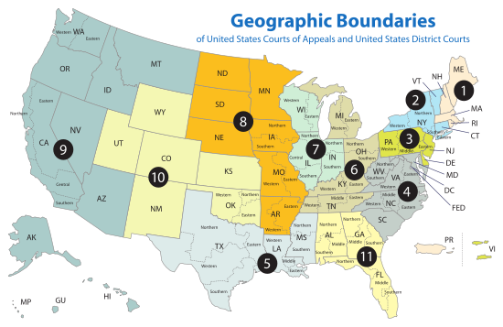
FAPE Tests
Lower
Standard
Lower
Standard
Confused!
Lower
Standard
Higher
Standard
Lower
Standard
Lower
Standard
Higher
Standard*
Lower
Standard
Notes:
In FAPE case, the U.S. Courts of Appeal for the various Circuits developed different standard to determine whether an student’s education had conferred educational benefit
Higher standard-The Meaningful benefit standard-3rd, 5th, & 6th ” (Quote from Polk)
Lower standard-The de minimis standard2nd, 4th, 7th, 8th, 10th, & 11th
The most recent of these standards was the 10th circuit decision in Endrew v. Douglas County School District
Confused circuit-Some panels going with the de minimis standard and some the meaningful benefit standard

Slide 41
Endrew F. v. Douglas County School District R1
At the private school, Endrew was provided with academic and behavior support including a Behavior Intervention Plan (BIP)
His behaviors decreased, and he began to make gains in academics
The parents and public school discussed having him return, but the IEP team did not adopt the private school program, including the behavioral planning
His parents asked the school district for reimbursement of the private school tuition, claiming that he was not receiving FAPE
Endrew was a student with Autism and ADHD
His parents had concerns and shared them with the IEP team
(a) goals and objectives on his IEP did not change much from grades 4th to 5th, and
(b) he was showing behavior problems in school that were not being addressed (e.g., wandering from his classroom, banging his head on his desk).
His parents asked the team to change his IEP and when they did not do so sufficiently, his parents withdrew Endrew and placed him in a private school

Slide 42
The Tenth Circuit’s
Educational Benefit Standard
Endrew F. v. Douglas County School District R1, 798 F.3d 1329, (10th Cir. 2014)
“The educational benefit mandated by the IDEA must merely be more than de minimis”
Notes:
Now famous quotation from the decisions was that the educational benefit offered Drew had to be “merely more than de minimis”

Slide 43
Appeal to the U.S. Supreme Court
On December 22, 2015 the parents appealed to the U.S. Supreme Court
Question Presented: What is the level of educational benefit school districts must confer on children with disabilities to provide them with the free appropriate public education guaranteed by the Individuals with Disabilities Education Act?
Certiorari Granted on September 29, 2016
Notes:
Would it be the lower de minimis standard of the 10th circuit or would it be the higher meaningful benefit standard of the 6th circuit

Slide 44
Supreme Court Ruling:
March 22, 2017
The High Court rejected the “merely more than de minimis” standard, vacating the decision and remanding the case back to the 10th Circuit to apply the new standard.
“To meet its substantive obligation under the IDEA, a school must offer an IEP reasonably calculated to enable a child to make progress appropriate in light of the child’s circumstances.’

Slide 45
The Rowley/Endrew Test
In the development of an IEP, has the school agency complied with the procedures set forth in the IDEA?
Is the IEP developed through the IDEA’s procedures reasonably calculated to enable the child to make progress that is appropriate in light of his or her circumstances?

Slide 46
“The IEP must aim to enable the child to make progress. After all, the essential function of an IEP is to set out a plan for pursuing academic and functional advancement”
-Endrew F., 2017, p. 11-
Notes:
progress monitoring will need to be supported by user-friendly and efficient data analytics and technology. The student’s record of progress across a year of instruction, such as can be provided by formative assessments and benchmarking assessments, (Abrams, McMillan, & Wetzel, 2015; Crawford, 2014), will also be vitally important

Slide 47
The Colorado District Court’s Decision on Remand-2/12/18
“I conclude that (Endrew) and his parent have met their burden to prove that the District’s IEP failed to create an educational plan that was reasonably calculated to enable Petitioner to make progress, even in light of his unique circumstances. The IEP was not appropriately ambitious because it did not give (Endrew) the chance to meet challenging objectives.”

Slide 48
The Colorado District Court’s Decision on Remand-2/12/18
“Accordingly, I reverse the Administrative Court Agency decision denying (Endrew) and his parents’ request for reimbursement of his tuition, transportation costs as well as reasonable attorneys; fees and litigation costs.”
The District’s inability to properly address Petitioner’s behaviors that, in turn, negatively impacted his ability to make progress on his educational and functional goals, also cuts against the reasonableness of the April 2010 IEP (Endrew v. Douglas County School District, 2018, p. 17).
36

Slide 49
Paris School District v. A.H. (2017)
  The management plan was not developed in a timely manner.
  The district supposed plan was not attached to the student’s IEP or referenced in the IEP
  The plan consisted of two pages without dates or signatures.
  The behavior plan lacked substance because it did not address specific behaviors noted by the parents, school, and evaluation
  The behavior plan did not specifically address how teachers were to manage the student’s behaviors
A school district appealed a due process hearing officer’s decision on a denial of FAPE because of an inadequate behavior plan
The hearing officer’s ruling that the behavior management plans for 2 years were inadequate was upheld because:

Slide 50
Paris School District v. A.H. (2017)
“ The Court agrees with the Hearing Officer's conclusion that the behavior plans were inadequate, especially in light of the higher standard of Endrew F. that must now be applied”(Paris, p. 8).
While the IDEA does not explicitly mandate a behavior plan, Endrew F.’s standard may require that given a child's circumstances he/she’s IEP may require one.
“A.H.'s circumstances required that any IEP address behavior issues. The Court agrees with the Hearing Officer's conclusion that the behavior support plans in place were inadequate” (Paris, footnote 10).

Slide 51


Now what do we do?
  Suggestions for Legal changes to IDEA
  Take Aways for IEP teams

Slide 52
Suggestions: Change FAPE Standard in IDEA
Ensure law incorporates Endrew F. standard (standard would not just be in caselaw)
“A free appropriate education consists of special education and related services that
(a)Have been provided at public expense, under public service and direction, and without charge;
(b) Meet the standards of the State educational agency;
(c ) include an appropriate preschool, elementary, or secondary school education in the State involved; and
(d) Are provided in conformity with the individualized education program which is collaboratively developed to enable a student to make progress appropriate in light of his or her circumstances and is implemented as written“
(Yell, 2019, p. 21).

Slide 53
Suggestions: Include PBIS in IEPS to Address Behavior Concerns
Support the use of PBIS in IEP’s for students with behavioral needs
“To ensure that each student receives an education that allows him or her to make progress in light of the student’s circumstances, the IEP team must consider the needs for positive behavioral interventions and supports for students with disabilities whose behavior impedes their learning or that of other, and, when determined necessary to ensure FAPE, include or revise needed behavioral supports in the student’s IEP” (Yell, 2019, p. 22).

Slide 54
Suggestions: Expand Legal Mandate for FBA’s
Expand the legal mandates for FBA’s beyond manifest determinations with its potential change of placement
“A functional behavioral assessment shall be conducted with students whose behaviors impede their learning or the learning of others to guide the implementation and development of students’ individualized education program or behavior intervention plan” (Yell, 2019, p. 24)

Slide 55
Take Aways for IEP Teams
Expect Progress
Address Behavior
Collaborate with Parents

Slide 56
Collaborate with Parents
To encourage effective collaboration, the strengths and challenges that parents share should be considered
  Students spend most of their time with their families; and
  Parental concerns about behaviors can provide background for what might work or be needed at school

Slide 57
Expect Progress
Assess
(PLAAFP or FBA)
Reflect
(Improvements?)
Collect
(Baseline & Ongoing Data)

Slide 58
Address Behavior
Behavior and functional performance need to be included in program planning
Goals addressing behavior might be:
  needed for an IEP; and/or
  Connected to interventions that might include a FBA and BIP/BSP

Slide 59
For More Information

Slide 60
Useful Resources
U.S. Department of Education, Office of Special Education and Rehabilitative Services (2007). Questions and Answers on Response to Intervention (RTI) and Early Intervening Services (EIS), 47 IDELR 196 (OSERS 2007).
U.S. Department of Education, Office of Special Education & Rehabilitative Services, OSEP Policy Documents, https://www2.ed.gov/policy/speced/guid/idea/memosdcltrs/index.html#pl
OSEP Policy Support Documents: https://www2.ed.gov/policy/speced/guid/idea/memosdcltrs/index.html#psd
Topic Index of OSEP Policy Documents: https://www2.ed.gov/policy/speced/guid/idea/letters/revpolicy/index.html
OSEP Policy Letters: https://www2.ed.gov/policy/speced/guid/idea/memosdcltrs/index.html#pl
U. S. Department of Education. (Dec. 7, 2017). Questions and Answers (Q&A) on U.S. Supreme Court Case Decision Endrew F. v. Douglas County School District Re-1. Retrieved fromhttps://www2.ed.gov/policy/speced/guid/idea/memosdcltrs/qa-endrewcase-12-07-2017.pdf

Slide 61

National Center on Positive Behavior Interventions & Supports (pbis.org)

Slide 62
Select References
Albuquerque Public Schools, 72 IDELR 227 (SEA NM 2018).
El Paso Independent School District v. Richard R. 50 IDELR 256 (W.D. 2008).
Endrew F. v. Douglas Country School District, 580 U.S. ___ (2017);
Endrew F. v. Douglas Country School District, Civ. Action No. 12-cv-2620-LTB (D. Colo. February 12, 2018).
Hendrick Hudson District Board of Education v. Rowley, 458 U.S. 176 (1982).
Individuals with Disabilities Act, 20 U.S.C. §§ Section 1414 et seq. (2006 & Supp. V. 2011).
Kern, L., George, H. P., Evanovich, L. L., & Martinez, S. (2019). Addressing the need for progress in special education: Understanding Endrew F. and the role of special educators. Journal of the American Academy of Special Education Professionals (JAASEP) Spring/Summer 2019 online
K.W. ex rel. J.W. v. Tuscaloosa County School System, 73 IDELR 157 (N.D. AL. 2018).
President’s Commission on Excellent in Special Education, A new era: Improving special education for children and their families (Google it!)
Yell, M. (accepted, 2019). Endrew F. v. Douglas County School District (2017): Implications for educating students with emotional and behavioral disorders. Behavioral Disorders

Slide 63

Miami, FL
Hyatt Regency Miami
March 11-14, 2020
For more information, visit:
conference.apbs.org

Slide 64
