Slide 1
Session D-9 Installing Suicide Prevention District-wide through Community Partnerships
Tim Knoster (McDowell Institute: Bloomsburg University)
Danielle Empson (McDowell Institute: Bloomsburg University)
Joanne Troutman (Greater Susquehanna Valley United Way)
Keywords: Mental Health, Systems Alignment, and Evaluation

Slide 2

CALL FOR
PAPERS OPENS
JUNE 2019
Miami, FL
Hyatt Regency Miami
March 11-14, 2020
For more information, visit:
conference.apbs.org

Slide 3
Where are you in the implementation process? Adapted from Fixsen & Blase, 2005
Exploration & Adoption
We think we know what we need so we are planning to move forward (evidence-based)
Installation
Let’s make sure we’re ready to implement (capacity infrastructure)
Initial Implementation
Let’s give it a try & evaluate (demonstration)
Full Implementation
That worked, let’s do it for real and implement all tiers across all schools (investment)
Let’s make it our way of doing business & sustain implementation (institutionalized use)

Slide 4
Leadership Team Action Planning Worksheets : Steps
Self-Assessment: Accomplishments & Priorities
Leadership Team Action Planning Worksheet
Session Assignments & Notes: High Priorities
Team Member Note-Taking Worksheet
Action Planning: Enhancements & Improvements
Leadership Team Action Planning Worksheet

Slide 5
Tertiary Prevention:
Specialized
Individualized
Systems for Students with High-Risk Behavior
SCHOOL-WIDE
POSITIVE BEHAVIOR
SUPPORT FRAMEWORK:
~5%
~15%
Secondary Prevention:
Specialized Group
Systems for Students with At-Risk Behavior
Primary Prevention:
School-/Classroom-
Wide Systems for
All Students,
Staff, & Settings
~80% of Students
Students
Staff
Parents/Families
Notes:
A well tested framework for ensuring effectiveness;

Slide 6
Supporting Social, Emotional and Behavioral Competence &
Academic Achievement and Safety
School-Wide PBIS
OUTCOMES
Supporting
Decision
Making
Supporting
Student
Behavior
DATA
PRACTICES
SYSTEMS
Supporting
Staff Behavior
Notes:
In general, the practices re addressable through strategic and sustainable professional development (e.g., establishing expectation, teaching and reinforcing the desired expectations/behaviors, increasingly building rapport with emphasis on students at greatest risk).
When schools struggle, it is often due to difficulties in installing the systems that reflect data-based decision-making (e.g., universal and advanced tier team-decision making schedules and processes).

Slide 7
Experimental Research on SWPBIS
SWPBIS Experimentally Related to:
Reduction in problem behavior
Increased academic performance
Increased attendance
Improved perception of safety
Reduction in bullying behaviors
Improved organizational efficiency
Reduction in staff turnover
Increased perception of teacher efficacy
Improved Social Emotional competence

Slide 8
PBIS Provides a Solid Foundation…. but More is Needed…
Many schools implementing PBIS struggle to implement effective targeted (Tier 2) and individual-intensive (Tier 3) interventions and supports
Youth with “internalizing” issues may go undetected
PBIS systems (although showing success in social climate and discipline) often do not address broader community data and mental health prevention.

Slide 9
Interconnecting Systems
Need a structure and process for education and mental health systems to interact in an effective and efficient manner.
These interactions are guided by key stakeholders in education and mental health/community-based systems.
Leaders with authority to allocate. resources, change role/functions of staff, and impact policy need to be engaged.

Slide 10
ISF Enhances MTSS Core Features
Effective teams that include community mental health providers
Data-based decision making that include school data beyond ODRs and community data
Formal processes for the selection & implementation of evidence-based practices (EBP) across tiers with team decision making
Early access through use of comprehensive screening, which includes internalizing and externalizing needs
Rigorous progress-monitoring for both fidelity & effectiveness of all interventions regardless of who delivers
Ongoing coaching at both the systems & practices level for both school and community employed professionals
Notes:
Quick review
Same as PBIS RTI MTSS (labels not as important as ensuring core features needed for installing EBPs)
*Highlight that ISF is not something “new” – it is enhancing existing framework/structure

Slide 11
Situating Suicide Prevention within PBIS
Strategies to support students known to be at higher risk of suicide
Individualized student interventions and supports
Crisis response and community partnerships
Ongoing program changes based on progress monitoring associated with students response to intervention
Strategies to identify and support students that may be at risk for suicide
Targeted training for specialized staff (e.g., school mental health professionals, school nurses, administrators)
Targeted small group interventions for students
Suicide risk-screening and/or assessment
Approaches that create emotionally and physically safe environments for students
Gatekeeper training for staff, students and families
Social-emotional learning interventions to enhance protective factors (e.g., healthy coping, help-seeking)
School-wide initiatives to increase protective factors to reduce risk factors (e.g., bullying prevention, trauma-informed practices reflecting rapport, clarity of expectations, positive reinforcement)
School-wide, classroom, and individual-level data collection and analyses
PBIS Core Components
Evidence based interventions and strategies.
Data informed decision making.
System development to enable accurate and durable implementation
School-based Suicide Prevention
Policies and procedures for prevention, intervention and postvention
Education for students, staff, and families
Screening and assessment

Slide 12
All Journeys Start with a First Step
Most districts start by requesting “gatekeeper” training such as YMHFA, QPR or other programs
However, it is important to view training in context
This initial point of entry requires meeting people where they are at (as opposed to where we wish they would be) while applying multi-tiered logic
Notes:
Pass out guiding questions handout

Slide 13
Examples of Tier One Programs and Practices to Enhance Social, Emotional, & Behavioral Wellness
UNIVERSAL PREVENTION
PBIS implementation with fidelity emphasizing:
Practices
3-5 Positive Stated Expectations
High Frequency Positive Reinforcement of Expectations
Building Rapport
Systems & Data
Functioning Universal Prevention Team
Functional data system
Data used by Universal Prevention Team
Evidence-based SEL Curriculum with a bully prevention & substance abuse prevention component
Universal screening
Professional development emphasizing:
ACEs & Trauma
Core preventive approaches (Positive Behavior Support) that are trauma informed across all classrooms
Gatekeeper training

Slide 14

Our Mantra: To fight for the health, education and financial stability of every person in every community
Our Mission: To address the root cause of social problems in our community
Our Model: Together we can do more – collective impact

Slide 15
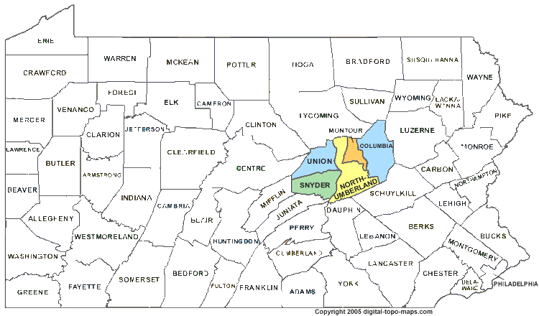
Greater Susquehanna Valley/Columbia-Montour Region
Population > 270,000
Rural communities
Two primary United Ways
17 school districts
3 Hospitals/Health Systems
Somewhat homogenous population

Slide 16
PennsylvaniA Youth Survey (PAYS) – 2017 data
Percentage of students who have:
felt sad or depressed in the last twelve months
Columbia | Northumberland | Snyder | Union
38.2% | 41.2% | 30.1% | 37.3%
felt so sad, they stopped doing activities
Columbia | Northumberland | Snyder | Union
23.4% | 25.9% | 18.1% | 20%
considered suicide
Columbia | Northumberland | Snyder | Union
17.7% | 16.5% | 12.2% | 14.4%
planned suicide
Columbia | Northumberland | Snyder | Union
14.7% | 15.5% | 9.9% | 13.6%

Slide 17
Up Until Now
2013 – Behavioral Health & Addiction Impact Council formed
2016 – Council reorganized with new leadership
2017 – Started offering direct supports/trainings to schools; Began organically working with the McDowell Institute to make school connections
Summer 2018 – First offering of Social Leadership Institute where McDowell presented
Dec. 2018 – Formed the Youth Mental Health Taskforce (40+ school personnel)
March 2019 – Completed and presented regional PAYS analysis results to
May 2019 – School-Based Behavioral Health Summit at the Intermediate Unit with McDowell
Summer 2019 – Two UW staff trained in YMHQPR training; One trained in YMHFA; One trained in Trauma; McDowell outreach to school districts to train trainers; Launched public Suicide Prevention campaign

Slide 18
Where We Are & Where We Are Going
2019-20 Academic Year
Training
12 educational systems signed up to credential QPR trainers
Developing a “training clearinghouse” in partnership with the Intermediate Unit
Curriculum
Many schools participating in Too Good for Drugs/Too Good for Violence
Working to offer partnership to evaluate district-level and building-level data to make recommendations about SEL curricula and other MTSS related supports
Youth Mental Health resources
Piloting our first “Community School”
Advocating with insurance providers to expand benefits for school-based behavioral health
Measurement
100% of schools in SUN counties signed on to participate in PAYS

Slide 19
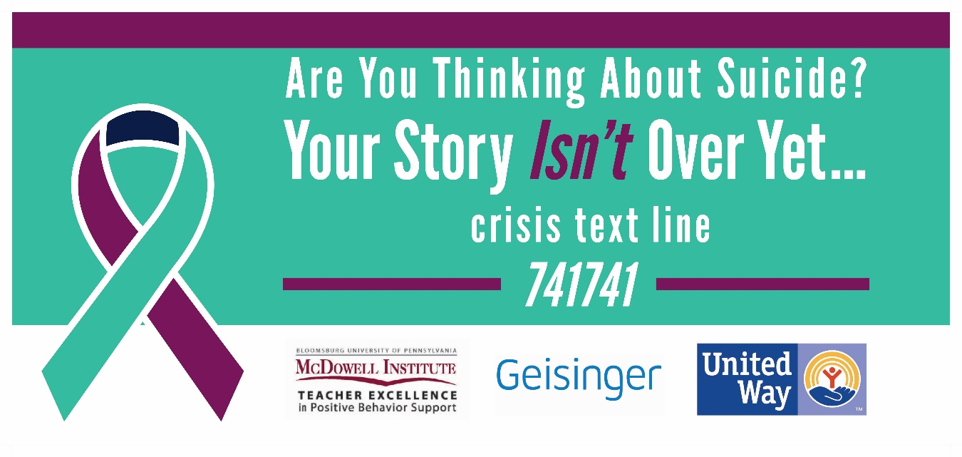
Where We Are & Where We Are Going (continued)
2019-20 Academic Year
Awareness (pooled resources)
Designed a Suicide Prevention campaign ongoing through December – banners, billboards, video, radio, newspaper and presence in districts in the fall
Kindness campaign to launch February 2020
Launching regional Trauma and Resiliency initiative spring 2020

Slide 20
Regional Approach: School District Examples
Milton Area School District
Warrior Run School District

Slide 21
Case Example: Milton Area School District 2017-2018
Student enrollment of 2,223 students comprised of 86% White, 3% Black, Latino-Hispanic 7% and 4% Other
182 teachers, 108 staff, and 16 administrators
Largest industries: food manufacturing/distribution, trucking & steel
Located in rural Northumberland and Union counties
3 Elementary Schools, 1 Middle School and 1 High School
Each school is at different stages of implementation of the PBIS framework
352 students receive special education (17.08%)
120 students speak English as their second language (4.5%) 69 students currently receiving ELL services
Median household income of $38,311.00 / year
56% of students qualify for free or reduced lunch

Slide 22
Going Beyond ODRs: Pennsylvania Youth Survey (PAYS)
Voluntary survey conducted with 6, 8, 10 and 12 grade students to learn about their behavior, attitudes and knowledge concerning risk and protective factors in their lives.
The survey is conducted on an every other year basis and is sponsored through the Pennsylvania Commission on Crime and Delinquency in collaboration with the Pennsylvania Department of Education.
Approximately 85% of school districts in Pennsylvania are projected to conduct the PAYS during 2019.
Primary focus is on 1) providing school leaders with critical information concerning changes in patterns in the use and abuse of harmful substances and behaviors, and 2) assessing risk factors that are related to undesired behaviors and the protective factors that help guard against concerning behavior.

Slide 23
Case Example: MASD
Priorities Reflected in MASD PAYS Data (2015 & 2017):
Mental Health & Risk for Suicide
4 out of 10 students indicted “at times I feel I am no good at all” (41.4%)
4 out of 10 students indicated “felt sad or depressed most days in the past 12 months” (44.5%)
2 out of 10 students reported “seriously considered attempting suicide” (21%)
Experiences with Bullying
2 out of 10 students reported “being bullied in the past 12 months” (21.9%)
Being Threatened with Violent Behavior
3 out of 10 students report being threatened to be hit or beaten up on school property in the past 12 months (31.2%)
1 in 10 students report having been hit or beaten up in the past 12 months (13.9%)
Substance Access and Use
4 out of 10 students report having tried beer, wine or hard liquor in past 30 days (41.3%)
1 out of 2 students report gaining access to alcohol from family / religious celebrations (51.5%)
Nearly 2 of 10 students report “having smoked cigarettes” (19.4%)
Approaching 1 of 10 students indicate “using prescription pain relievers without doctor telling them to take them” (7.9%)
with primary source of those drugs being family or friends
Stress Associated with Limited Family Resources
2 out of 10 students report “worrying about the family running out of food” (19.8%)
Almost 1 out of every 10 students indicate having “skipped a meal due to limited family money” (8.9%)

Slide 24
Using PAYS Data: Logic Model & Action Plans (Adapted from Safe Schools/Healthy Students: SAMHSA)
Designing, implementing and sustaining effective data-driven school-based programs to enhance social-emotional-behavioral wellness of students and staff requires the application of multi-tiered logic within an organized framework.
Once the multi-tiered logic is applied through the logic model framework, attention turns to developing action plans to implement the identified activities, curricula, programs, services, strategies and policies (see middle column from the logic model framework).
Needs & Gaps | Data Sources | Objectives | Activities, Curricula, Programs, Services, Strategies & Policies | Partner Roles and Resources | Process Measures | Impact & Outcome Measures
Objective | Activity | What action will occur? | Who will carry it out? | What resources are needed? | By when and how to monitor? | Communication: How and Whom? | Resources needed | Status Updates

Slide 25
Progress & Accomplishments to Date: Practices- Professional Development
Gatekeeper Training
YMHFA
- training for targeted leadership staff across their five school buildings
- two cohorts (60 staff)
- administrators, guidance, members of PBIS Teams along with SAP
- training delivered through partnership among:
1) McDowell Institute,
2) GSVUW, and
3) BHARP
QPR
- training of all teachers (K – 12) across all five schools
- nested within in-service date with repeated session provided to over 200 professional staff
- Training bus drivers and cafeteria workers
- Expanded access to general community
Positive Behavior Support in the Classroom: Virtual Modules across K-12 Buildings and Classrooms
- McDowell Institute virtual modules with embedded video (5 in total) for teachers
- Follow up discussion through PLCs
- Built in to Instructional Coaching in an ongoing basis

Slide 26
Progress & Accomplishments to Date: Practices- SEL Curriculum & Universal Screening
SEL: Positive Action
- Initially implemented across all Kindergarten classrooms in 2017-18
- Targeted roll out across all primary grades in 2018-19 & 2019-20
- Targeted roll out in Pre-K programs as well as intermediate grades, middle school and high school beyond 2020
Universal Screening
- Initial pilot work with screening in 2018-19 and fall 2019
- Utilizing a protocol to select universal screener summer & fall 2019
- Formal installation of universal screener 2020

Slide 27
Progress & Accomplishments to Date: Systems, Data & Practices – PBIS & ISF
Fidelity of implementation of PBIS Framework at Universal (Tier One) Level
Two of three elementary schools recognized by the PA PBS Network (Bannered) at Tier One (2018-19)
The third elementary school is on the verge of being bannered at Tier One (should occur 2019-20)
Middle school is on the verge of being bannered at Tier One (should occur 2019-20)
High school is formally launching implementation of the PBIS framework in fall 2019
Implementation of the PBIS Framework with ISF features at Advanced Tiers
Two elementary schools bannered at Tier One working towards fidelity and recognition at advanced tiers reflecting alignment of PBIS endeavors with their Student Assistance Program. This also includes the situation of high fidelity Check-in Check-out as well as function-based Positive Behavior Support
One elementary working towards bannering at Tier One is concurrently monitoring advanced tier work occurring at the other two elementary schools.
Middle School, once bannered at Tier One, will expand focus to roll out high fidelity targeted supports
High school, despite formally launching the PBIS framework fall 2019, based on need are designing mentoring structures based on person-centered planning principles as they build capacity.

Slide 28
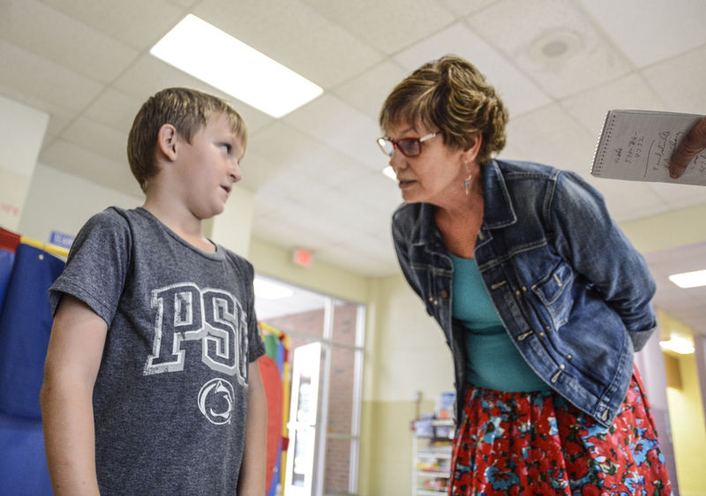
An Example: Warrior Run School District
Community School Coordinator: Becky Perruquett
The residential “expert” in MTSS
Manages a caseload of advanced tier students partnering with their families
Trained in trauma-informed approach
Internal advocate for social-emotional trainings to be implemented for all staff
Ensures advanced tier student referrals to internal programs (afterschool) and external programs are occurring effectively
Serves as an on-site connector to human services programs and agencies
School district employee, dotted line reporting relationship to United Way

Slide 29
