Slide 1
J3 - Critical Systems that are Necessary to Support Effective Tier 3 Practices
Don Kincaid, Ed. D., Rose Iovannone, Ph.D.
University of South Florida
Topic: School-wide
Keywords: Tier 3, FBA/BIP/BSP, Individual

Slide 2
Virtual Forum Expectations
EXPECTATION | OVERALL Event | CHAT Tab | POLLS Tab (+Q&A)
BE RESPONSIBLE | Use a shared action plan for your team Complete session evaluations | Post positive on-topic comments Questions for the presenters go in the POLLs tab ⇨ | Add questions before and/or during session
BE RESPECTFUL | Limit distractions Follow up on your assigned action items | Use inclusive language | Use sincere phrasing Complete additional polls when prompted
BE SAFE | Take movement breaks Be aware of your stress level | Engage in productive dialogue | Ask solution-oriented questions
For Presenters | Ensure Files Tab has current materials and related weblinks | Monitor and remove inappropriate comments | Identify common Qs to address in final 15 minutes

Slide 3
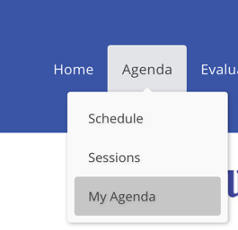

Tips for Participants
Finding Your Registered Sessions in Pathable
Your Personalized Schedule (My Agenda)
Locate the Agenda Menu, Select “My Agenda” from the drop-down, and you will see the sessions for which you are registered. A green check mark in the upper right corner indicates you are registered.

Slide 4
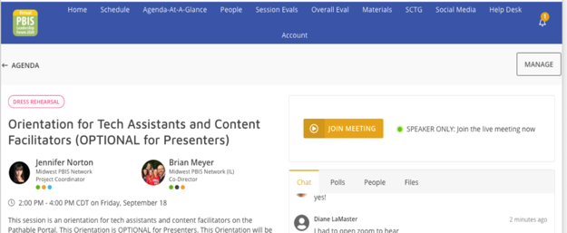
Tips for Participants
Navigating the Session Page
Session Details (Title, Presenters, Date & Time, Description, Keywords)
Join Session
Interact through Chat, Polls, & Uploaded Files
1.
2.
3.

Slide 5
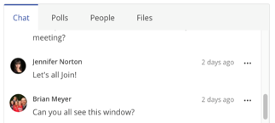
Tips for Participants
Chat, Polls, and Q&A
Use Chat for engaging with other participants around the session topic.
Presenters may use chat differently in specific sessions.
Follow overall Forum expectations for responsible, respectful, and safe chatting
2. Find the Q&A under Polls. Questions for presenters go there.
3. Some sessions have other Polls or more Specific Questions. Complete those when prompted
2.
1.
3.

Slide 6
Tips for Participants
Be careful of accidently navigating away
While participating in a live Session…Be Present!
If you navigate away from the live Session you will need to press the “Join Meeting” button to get back in.
What does navigating away look like? Here are some examples:
  Clicking on any area of the navigation menu
  Clicking on a Person’s name
2.
1.

Slide 7
Tips for Participants
Support is Available
If at any time you need support as a participant, use the Help Desk:

Slide 8
Objectives
Participants will:
  Define Tier 3 as a System of Support for students with intensive needs
  Discuss the Tier 3 myths and how they impact their setting’s implementation of Tier 3 processes
  Discuss essential components of a Tier 3 system
  Identify some tools and strategies to assess district/school capacity for Tier 3

Slide 9
Tier 3-System
Tier 3, overall, not systemic in most schools
  Collection of various “practices”
Often, seen as a special education function
Often viewed as a compliance exercise
Myths often impede implementation

Slide 10
Question
Which myths seem to impact your experience with districts attempting to implement Tier 3 supports?
Write them in the chat box, please

Slide 11
Tier 3 Myths
Students must progress sequentially through each tier— a student must receive Tier 1 before moving to Tier 2, and s/he must receive Tier 2 before moving to Tier 3.
Tier 1 and Tier 2 must be in place and perfectly functional before we start Tier 3 supports.
Tier 2 supports are not necessary at Tier 3
Tier 3 may only be implemented by experts, so all staff should become experts in Tier 3 assessment, intervention and implementation.
Students in need of Tier 3 have either significant academic deficits or externalizing behaviors, and these deficits or behaviors are rooted in the child.
Conducting diagnostic or functional assessment always leads to high quality Tier 3 supports.
Most Tier 3 interventions are complex and difficult to implement. We just need an easy menu of interventions to choose from.
Tier 3 data collection is difficult, if not impossible, to accomplish especially with fidelity.
I can’t implement a Behavior Intervention Plan in a class with 20+ other students!
Do I just keep implementing the BIP forever?
As a Teacher, am I responsible for everything this student needs?
Special education is a Tier 3 intervention.
Compliance is all we need to be concerned about at Tier 3.

Slide 12
Critical Systems for Tier 3
Teaming
Identifying students
Staffing and Professional Development
Student/Family/Community Involvement
Assessments : QOL, Academic, Social, Physical
Comprehensive supports: BSP with hypotheses, formal and natural supports, Tier 3 is not separated from Tiers 1 and 2
Data systems exist for school and student Tier 3 team problem-solving
Evaluation of school and student team success
Notes:
Don to introduce

Slide 13
1. Teaming:
What! More teams?
13
Notes:
Don

Slide 14
Different Levels of Tier 3 Teams
District | School | Student
Charged with developing a consistent Tier 3 process across ALL schools. District leadership team plans PD, process, evaluation, etc. Expands membership to include community feedback and expertise. | Charged with developing a consistent Tier 3 process across ALL students. School leadership team organizes internal and external personnel and resources to meet needs of all students with intensive needs Develops process for seeking expertise | Charged with developing an effective Tier 3 process for one student. Determines level of need: brief consult, comprehensive plan, wraparound Makes a commitment to meeting frequently to assess, implement and evaluate
14

Slide 15
Organizing the School Level Tier 3 Team
Do you combine Tier 2 and 3 teams?
Do you have one systems level PBIS Team (all three tiers)?
Do you combine academic and behavior teams?
Getting the right membership:
  a) behavioral expertise,
  b) administrative authority,
  c) multi-agency supports (e.g., person centered planning, wraparound, RENEW)
  d) knowledge of students, and
  e) knowledge about the operations of the school across grade levels and programs
Do you have access to the broad areas of expertise that may be needed (behavioral, mental health, medical, etc.)
15

Slide 16
Tier 3 Student Support Teams
Individualized
Constructed in collaboration with the family and student
Matched to the support needs of students
  Brief consult - 2 people
  Comprehensive team - a few school staff, student and family members
  Wraparound – broader team with community, medical, mental health, law enforcement, etc.
16

Slide 17
Effective Teaming
School Tier 3 Team is not the place for individual student problem-solving.
Student team may identify systems issues to forward to School Tier 3 Team.
Both teams should have:
  a) regular meeting format/agenda,
  b) minutes,
  c) defined meeting roles, and
  d) a current action plan
17

Slide 18
2. Identifying students:
Isn’t there one tool to do it all?
Notes:
Lee

Slide 19
2. Identifying students: Recommendations
Use multiple strategies
  Disciplinary actions
  Universal screeners
  Responsiveness to tier 2 interventions
  Teacher nomination
  Teacher checklist of symptoms
  Undiscovered students
19

Slide 20
2. Identifying students: Common strategies
Disciplinary actions (e.g., office disciplinary referrals)
  Strengths:
      Identifies students with serious problem behavior
  Limitations:
      Only catches students with externalizing behavior
      Teachers may be reluctant to refer students with behavior problems that are not extreme
20

Slide 21
2. Identifying students: Common strategies
Responsiveness to tier 2 intervention
  Strengths:
      Good for identifying students who need more support
  Limitations
      Measures not precise (e.g., CICO ratings)
      Might not need tier 3 intervention
        Adaptations to tier 2 interventions, multiple tier 2 interventions might be effective
21

Slide 22
2. Identifying students: Common strategies
Universal screening
  Strengths
      Identifies students with internalizing problems
  Limitations:
      Schools not ready for universal screening
      Some students underreport symptoms/behaviors (e.g., EBD)
      Teacher nomination
22

Slide 23
2. Identifying Students: Checklist of Symptoms
BEHAVIOR | STUDENT NAME | RATING
Student cries excessively, for a number of weeks, when dropped off at school |  | never always 1 2 3
Student reports being very afraid of something (e.g., thunder, being alone, spiders, heights) |  | never always 1 2 3
Student isolates him/herself, never answers questions, is absent when required to speak before class |  | never always 1 2 3
Student fatigues easily, has difficulty concentrating, seems tense, reports disturbed sleep |  | never always 1 2 3
23

Slide 24
2. Identifying Students: Undiscovered students
Each month, teachers enter names of students they have had no contact with
Entered into schoolwide data base
Students identified who have had NO contact with any teacher
24

Slide 25
2. Identifying students: Recommendations
Use multiple strategies
  Disciplinary actions
  Universal screeners
  Responsiveness to tier 2 interventions
  Teacher nomination
  Teacher checklist of symptoms
  Undiscovered students
25

Slide 26
3. Staffing and Professional Development:
It takes a village!
Notes:
Steve
Staffing for overall function of district, school, student teams.
Effective Tier 3 requires new skills or applying old skills in new ways.
Who needs to know what to make Tier 3 work?
What skill sets are necessary to facilitate the process?
How do “facilitators” need coaching?

Slide 27
Staffing and Professional Development
Selection
Competency
Staff know what to do and how to do it well base on their role/function
Guidance and policy/practice resources
Personnel to Support Student
Training
Support Team Members
Interventionist(s)
Other educators who interact with the student
Other staff (e.g., lunch bus)
Coaching
Professional Development:
Improving educators’ competency to implement Tier 3 interventions and supports with fidelity through the development of knowledge, skills and ability. Includes training, coaching and technical assistance.
Notes:
Members of intensive support team
Administrative personnel (principal, assistant principal, deans, etc)
Person with knowledge about instruction (strong regular education teacher – may be rotating member)
Person with behavioral training (special education teacher or representative)
Clinical personnel (school psychologist, reading specialist, instructional consultant, school social worker, counselor, nurse, local mental health rep)
Additional support staff (school resource officer, parent liaison etc.)
Training
Specific sessions with formal activities designed for skill development
Coaching
Ensuring transfer from training to practice
On-site skill development, enhancing the skills through prompting and reinforcement
Technical assistance

Slide 28
Organizational Supports for Tier 3 Implementation
Necessary Supports
Helps with…
Leadership and Management
What to do, why do it and assistance to get it done
Professional Development
How to do it
Effective Sequence
Promoting Effective Environments
Make it easy to do it right
Fidelity of Implementation
28

Slide 29
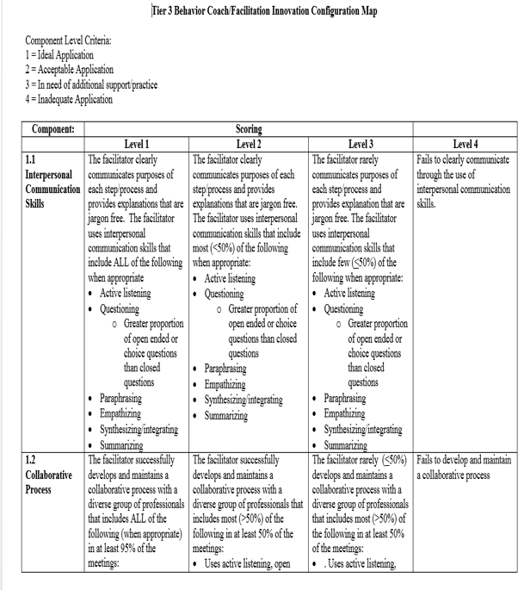
Tier 3 IC Map
Tool used to:
  Identify professional development needs for FBA/BIP Facilitators
  Establish baseline and ongoing improvement
  Can be used as needs-assessment, self-assessment, external assessment or combination

Slide 30
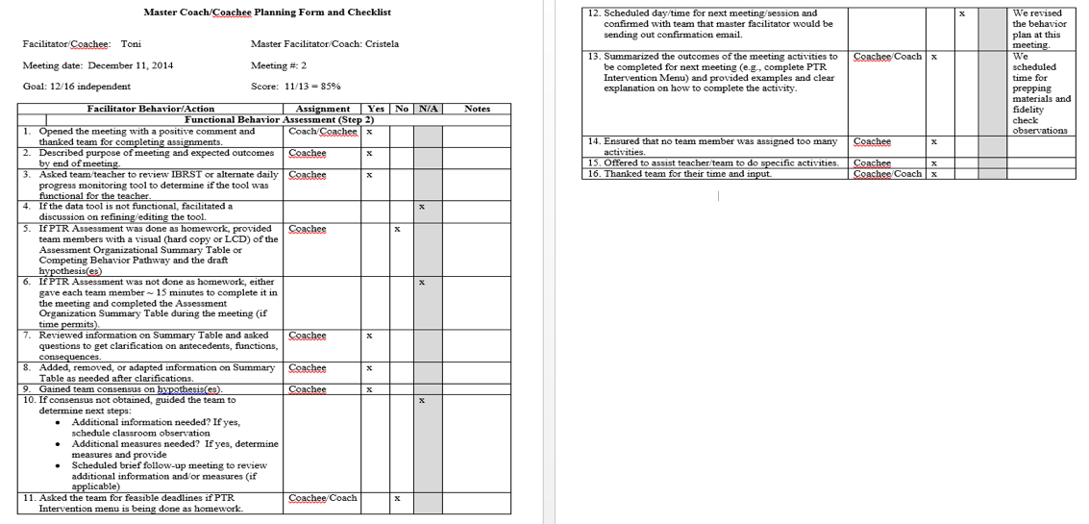
Coach-Coachee Pre-Planning Form

Slide 31
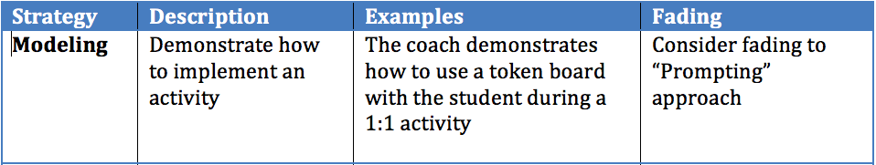
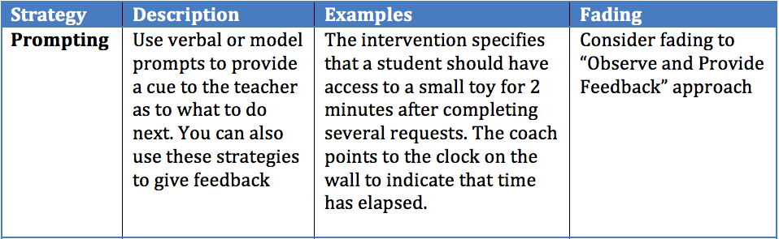
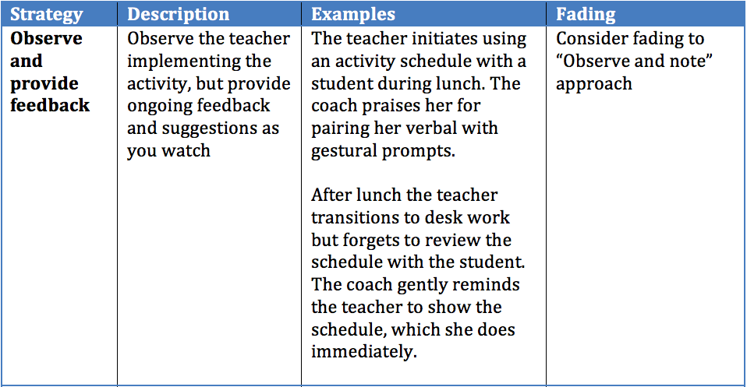
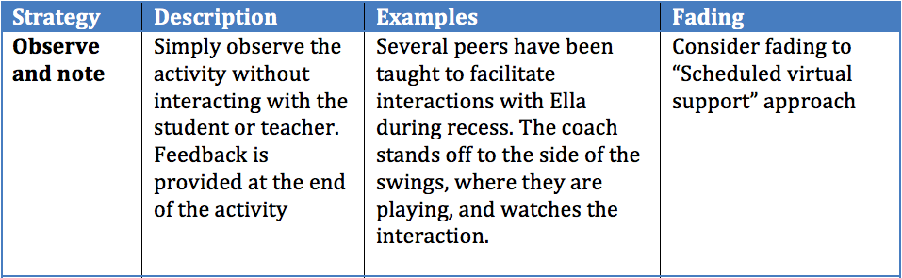
Coaching Teachers to Implement Interventions

Slide 32
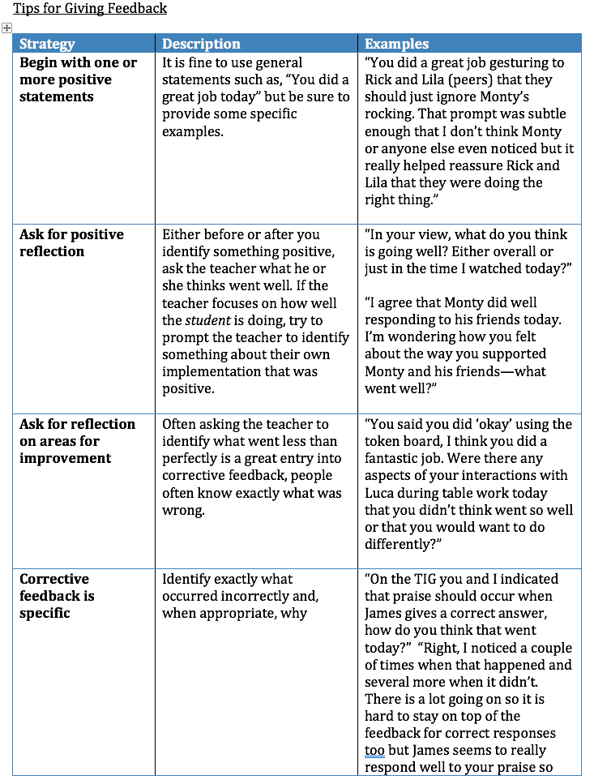

Slide 33
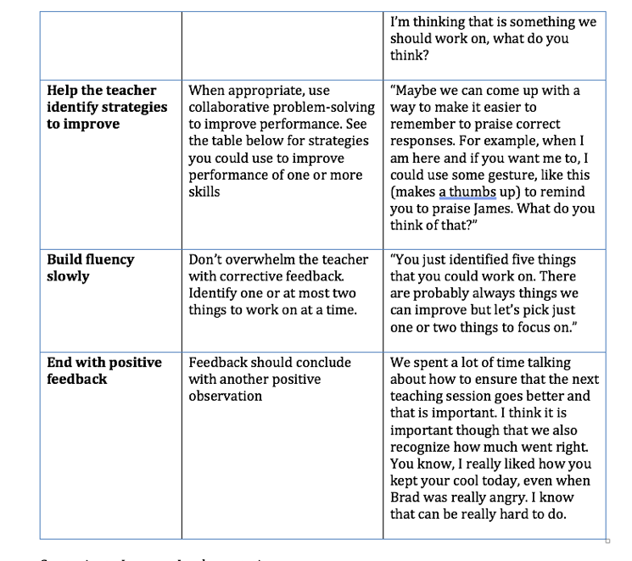

Slide 34
Sufficient Professional Supports
One Big Idea:
  We need to shift the focus of professional development from primarily workshops, presentations, institutes to job-embedded PD and coaching that will build competencies of professionals within authentic environments
  Not every professional needs the same level of competencies.
  Component-Scope and sequence of skills necessary; professional development processes to:
    Assess skill and PD needs
    Provide adequate PD to address needs
    Plan for practice-based coaching
    Evaluate outcomes of PD

Slide 35
4. Student/Family/Community Involvement
That village is really the VILLAGE!
“Interventions connecting families and schools are essential to valued youth behavioral and mental health outcomes.¹”
(www.pbis.org)
¹(Sheriden et al., 2019)
Notes:
Brandi

Slide 36
4. Student/Family/Community Involvement
That village is really the VILLAGE!
How do we engage families?
Positive Relationships
Multiple Forms of Two-Way Communication
Equity, access, & representation
Meaningful Decision-Making
www.pbis.org
Notes:
Brandi

Slide 37
4. Student/Family/Community Involvement
That village is really the VILLAGE!
How do we support students with complex needs?
Integrated approach to social, emotional, behavioral, & mental health support (single system).
Mental health for all!
Student outcomes (not service delivery) define success
PBIS/MTSS core features guide implementation
www.pbis.org
Notes:
Brandi

Slide 38
4. Student/Family/Community Involvement
That village is really the VILLAGE!
F MILIES
S UDENT
CO MUNITY
DUCATORS
Notes:
Brandi

Slide 39
5. Assessments:
What are they and who does them?
39
Notes:
Lee
Might talk about FBA as a fundamental assessment
Expand discussion to include: QOL, Academic, Social, Physical
Who might do such assessments?
Data vs assessments…attendance data vs FBAs different info learned from each
When good assessments are done, many interventions are just good teaching strategies

Slide 40
5. Assessments: What are they and who does them?
Purpose:
  To inform intervention development
      Functional Behavioral Assessment
  To assess student progress
      Immediate (reductions in problem behavior, increases in appropriate behavior, academic performance, social behavior)
      Long-term (social skills, quality of life)
  To determine if intervention is implemented as designed (treatment/intervention fidelity)
Notes:
Lee

Slide 41
5. Assessments: Who does them and how?
Determine resources
Select most important behaviors for measurement
Identify feasible assessments
      Time sampling procedures
      Brief assessments (academic)

Slide 42
5. Assessment: Examples
Intervention Component | Component Was Implemented
Break card was available throughout lesson | yes no partially n/a
At the start of the lesson, Calvin was reminded to use his break card when needed | yes no partially n/a
Calvin was prompted to use his break card when minor problem behaviors occurred | yes no partially n/a
An incidental opportunity was used to teach Calvin to use his break card | yes no partially n/a
Treatment fidelity
Quality of Life Assessment
What Do We Expect To Happen? | How Will We Measure This?
Breanna will participate in sports or other activities she enjoys | Coach and Brenna’s mother will be contacted monthly
Breanna will develop friendships | Circle of Friends questionnaire
Breanna will complete her school job | School psychologist will monitor
Does measurement of student outcomes match targeted behavior concern?
Notes:
Don

Slide 43
5. Assessments: Who does it?
Who is available in the school and whose job is it?
  Administrators
  School psychologists
  School counselors
  Behavior specialists
  Teachers/Other teachers
  Paraprofessionals
Develop systemic procedures to assure data are collected

Slide 44
6. Comprehensive Supports:
Matching the level of support to the level of need
44
Notes:
Lee
Might talk about FBA as a fundamental assessment
Expand discussion to include: QOL, Academic, Social, Physical
Who might do such assessments?
Data vs assessments…attendance data vs FBAs different info learned from each
When good assessments are done, many interventions are just good teaching strategies

Slide 45
6. Comprehensive Supports:
Matching the level of support to the level of need
Tier 3 is connected to Tiers 1 and 2
School & Classroom Wide
Individualized
Outcomes | Goals
Explicit Academic Instruction | Explicit Academic Instruction
School Expectations & Social Skills | Social Skills & Replacement Behaviors
Explicit Social & Emotional Instruction | Explicit Social & Emotional Instruction
Acknowledgement System | Function-Based Reinforcement Plan
Continuum of Disciplinary Consequences | Function-Based Consequence Strategies
Notes:
Brandi

Slide 46
6. Comprehensive Supports:
Matching the level of support to the level of need
One big idea:
  Multiple levels of tier 3
  Not a one-size fits all
  Component-continuum of supports across all tiers and Tier 3
  System provides data points for matching supports to needs
Wraparound based (Person-centered plans, functional analysis, multiple expertise)
Team based (PTR)
Consultant-based (Brief PTR)
Slice of Tier 3-tip of triangle
All levels use functional thinking: (Scott, Alter, Rosenberg, & Borgmeier, 2010)

Slide 47
Ideal Match Between Level of Problem Behavior and FBA Comprehensiveness
High
This quadrant represents inadequate comprehensiveness of FBA.
This quadrant represents adequate comprehensiveness of FBA
Intensity/Severity/Durability of Problem Behaviors
This quadrant represents adequate comprehensiveness of FBA
This quadrant represents unnecessary comprehensiveness of FBA.
Low
Low
High
Comprehensiveness of FBA

Slide 48
Example of Levels of Tier 3 Processes Related to FBAs
Efficient FBA
  FBA/BIP developed in one meeting (~60 minutes)
  Best for high frequency/low intensity behaviors
    Noncompliance, minor disruptions
    ERASE (Explain, Reason, Appropriate, Support, Evaluate)
Comprehensive FBA
  More intensive FBA/BIP process
  Multiple meetings (2-4) or one long meeting (>2 hours)
  Best for chronic, durable, intense behaviors
    Prevent-Teach-Reinforce
Wrap-Around
  Long-standing, extremely intense behaviors, mental health concerns, complex life events
  Multiple services, agencies or institutions
    Person-Centered-Planning

Slide 49
6. Comprehensive Supports:
Matching the level of support to the level of need
Testable hypothesis describes context & reinforcers
Definition of problem behaviors (or response class)
Description of function supported by data
Function-Based Positive Behavior Support Plan (BSP)
Plan to monitor fidelity and outcomes & adjust or fade supports based on data
BSP identifies replacement & desired behaviors (competing behavior pathway)
BSP includes antecedent, behavior, and consequence strategies
Notes:
Brandi

Slide 50
6. Comprehensive Supports:
Matching the level of support to the level of need
SETTING EVENT
ANTECEDENT
BEHAVIORS
CONSEQUENCES
Contextually Appropriate
Typical Consequences
Motivating Operations or SEs
Triggering Events
Contextually Inappropriate
Maintaining Function
Replacement Behavior
SETTING EVENT
MANIPULATIONS
ANTECEDENT
MANIPULATIONS
WAYS TO TEACH
BEHAVIORS
CONSEQUENCE
MANIPULATIONS
Minimize Likelihood
Neutralize
Withhold S^{D}
Add prompts
Increase S^{R}
Redesign the environment
  Predictability
  Physical arrangement
  Choice
  Instructional Variables
Add prompts
Explicitly teach replacement behavior
Shape from replacement to desired behavior
Provide function-based reinforcement for replacement behavior
Withhold function-based reinforcement for inappropriate behavior
Add reinforcers for desired behavior
(Crone, Horner, & Hawken, 2015)
IMPLEMENTATION PLAN

Slide 51
Continuum of Tier 3 Across Levels
Feature | Level 1 (efficient) | Level 2 (comprehensive) | Level 3 (wrap around)
Teaming | Team is small in size May only consist of a school-based consultant and teacher Family input is sought Student is included when appropriate | Team size expands to include multiple people within the school, the family and the student Team roles and responsibilities defined Consensus process established | Team size expands to include people from all areas of student’s life who are vested in ensuring student is successful Outside agencies and other supports are enrolled Includes person-centered planning models to develop a vision and targeted goals that lead to a wrap-around system of supports for the student
FBA | Gathering of FBA information primarily indirect methods (e.g., within structured meeting) with a hypothesis developed | Both indirect and direct methods of gathering FBA data used | In addition to the FBA, other data to be collected include: Strength-needs assessment Goals/vision reflecting voice of student and family Personal, family, and community resources Other assessment information to identify additional areas of need or conditions that inform intervention (e.g., medical exam)
BIP | Plan developed within the FBA meeting Primary intervention focuses on teaching and reinforcement strategies suggested by the hypothesis Plan addresses contextual/environmental factors that enhance success and minimize failure of the plan | Multiple component plan developed that links to the hypothesis. Safety plan developed if needed | Full range of intervention options considered Action plan that addresses goals developed from vision
Progress Monitoring and Follow-up | Plan for collecting student outcome data Plan for collecting fidelity of intervention implementation Plan for following up with team within reasonable time frame (e.g., 3 weeks) to review response to intervention Decision-making structure established for determining next steps based on response to intervention | In addition to fidelity and student outcome data, social validity, and alliance between facilitator of process and implementer of plan | Outcome measures broader than student change in behaviors (e.g., quality of life) Coordination of multiple agencies planned including consistent follow-up to determine progress in action steps to meeting goals derived from vision

Slide 52
7. Data Systems:
Do we have data to help use with problem-solving?
52
Notes:
Lee
Might talk about FBA as a fundamental assessment
Expand discussion to include: QOL, Academic, Social, Physical
Who might do such assessments?
Data vs assessments…attendance data vs FBAs different info learned from each
When good assessments are done, many interventions are just good teaching strategies

Slide 53
Data Systems
Do you have a data system that does the following:
  Identify students needing tier 3 supports
  Provide baseline (pre-intervention) data that lets you know how all students needing t3 are doing before intervention and post (after intervention)-how all students are doing after intervention
  Drill into data by looking at students in specific schools, grade levels, categories, classrooms
  Provide fidelity data
  Identify the specific problem and replacement behaviors
  Identifies the interventions being implemented
Data are required for making data-based decisions

Slide 54
7. Data Systems:
Do we have data to help use with problem-solving?
Data systems exist for school and student Tier 3 team problem-solving: Aggregated (i.e., overall school-level) Tier 3 data are summarized and reported to staff at least monthly on (a) fidelity of support plan implementation, and (b) impact on student outcomes.
Use of disaggregated data for deeper analysis
Use of data and data-based problem-solving occurs at district, school, student team levels
Data are used to track access and success of students receiving Tier 3 supports
Notes:
Steve

Slide 55
7. Data Systems:
Do we have data to help use with problem-solving?
Decision Support Data System
System for identifying, collecting, and analyzing data for decision-making by program administrators and practitioners. These systems enable educators to make informed and intentional decisions about critical implementation supports. The data system needs to provide timely, accurate, and reliable data for decision-making.
Gathers three types of data: fidelity, outcome, and systemic. Programs need all of these types of data to celebrate successes and diagnose issues that emerge during implementation. This helps an organization understand if there is a process or performance issue, or an issue with the program and its fit.
Notes:
Steve

Slide 56
7. Data Systems:
Do we have data to help use with problem-solving?
Data System Feature | Description and Function of Each Data System Feature
People | Coordinator to manage data collection, analysis, interpretation, and decisions Data collector(s) Data entry person Data system technician
Information | Data analyzed and summarized Form/format for sharing data with others
Things | Assessment forms and protocols Electronic data storage system
Schedules | Standardized time and process to gather data review data act on data
56

Slide 57
8. Evaluation:
Did we do what we planned and did it work?
57

Slide 58
Different Levels of Tier 3 Evaluation
District | School | Student
How many students received Tier 3 support? Were students successful? Were all subgroups successful (disability types, ethnicity, type of program)? Evaluation of overall system: (Training, coaching, behavioral expertise, etc.) | How many students received Tier 3 support? Did we implement with integrity? Were students successful? Were all subgroups successful (disability types, ethnicity, type of program)? Evaluation of overall system: (Training, coaching, behavioral expertise, etc.) | Did this student get what they needed in our Tier 3 support? Did we implement with integrity? Was this student successful? Do we need to make changes? Do we maintain or begin to fade or supports?
58

Slide 59
What to Evaluate at Tier 3
Minimum:
  a) systems for Tier 3
  b) fidelity of support plan implementation, and
  c) impact on student outcomes.
Additional areas to evaluate:
  a) technical adequacy of Tier 3 processes
  b)student, teacher, parent perceptions and satisfaction.
  c) quality of life outcomes (friends, community restoration, health, graduation, family success, etc.)
59

Slide 60
Tiered Fidelity Inventory: Tier 3
3.1 Team Composition
3.2 Team Operating Procedures:
3.3 Screening:
3.4 Student Support Team:
3.5 Staffing:
3.6 Student/Family/Community Involvement
3.7 Professional Development:
3.8 Quality of Life Indicators:
3.9 Academic, Social, and Physical Indicators:
3.10 Hypothesis Statement:
3.11 Comprehensive Support:
3.12 Formal and Natural Supports:
3.13 Access to Tier 1 and Tier 2 Supports:
3.14 Data System:
3.15 Data-based Decision Making:
3.16 Level of Use:
3.17 Annual Evaluation

Slide 61
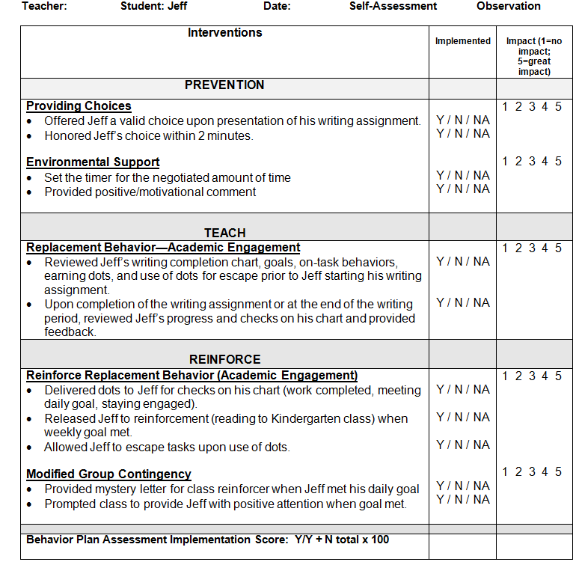
Jeff Coaching/Fidelity Plan

Slide 62
Case Study 1- Mike: Behavior Rating Scale
Behavior
Screaming | 9+ times 7-8 times 5-6 times 3-4 times 0-2 times | 5 4 3 2 1 | 5 4 3 2 1 | 5 4 3 2 1 | 5 4 3 2 1 | 5 4 3 2 1 | 5 4 3 2 1 | 5 4 3 2 1 | 5 4 3 2 1 | 5 4 3 2 1 | 5 4 3 2 1 | 5 4 3 2 1 | 5 4 3 2 1
Hitting | 8+ times 6-7 times 4-5 times 2-3 times 0-1 times | 5 4 3 2 1 | 5 4 3 2 1 | 5 4 3 2 1 | 5 4 3 2 1 | 5 4 3 2 1 | 5 4 3 2 1 | 5 4 3 2 1 | 5 4 3 2 1 | 5 4 3 2 1 | 5 4 3 2 1 | 5 4 3 2 1 | 5 4 3 2 1
Expressing Frustration | 40%+ 30-40% 20-30% 10-20% 0-10% | 5 4 3 2 1 | 5 4 3 2 1 | 5 4 3 2 1 | 5 4 3 2 1 | 5 4 3 2 1 | 5 4 3 2 1 | 5 4 3 2 1 | 5 4 3 2 1 | 5 4 3 2 1 | 5 4 3 2 1 | 5 4 3 2 1 | 5 4 3 2 1
Transition to Non-preferred | Whimper or squeal Louder than indoor voice Outdoor play voice Louder than outdoor play Ear penetrating | 5 4 3 2 1 | 5 4 3 2 1 | 5 4 3 2 1 | 5 4 3 2 1 | 5 4 3 2 1 | 5 4 3 2 1 | 5 4 3 2 1 | 5 4 3 2 1 | 5 4 3 2 1 | 5 4 3 2 1 | 5 4 3 2 1 | 5 4 3 2 1
01/15

Slide 63
Step 5: Evaluation

Slide 64
Step 5: Evaluation

Slide 65
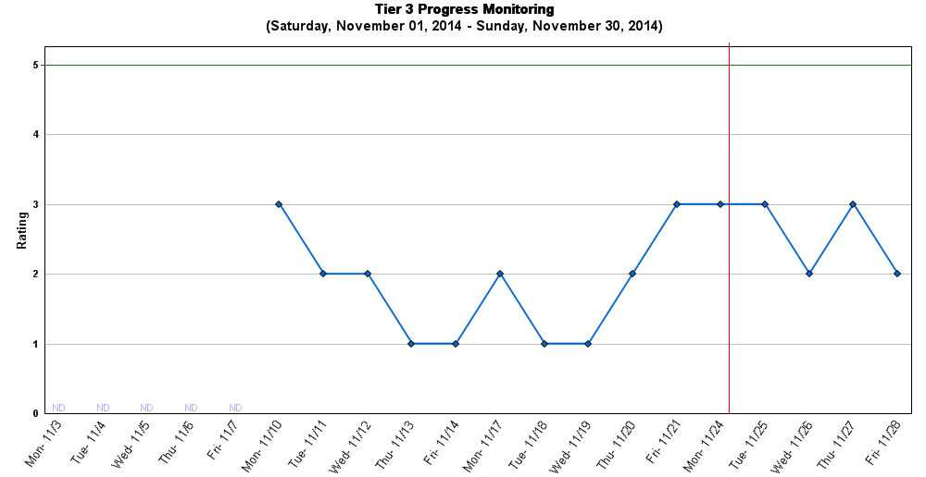
Appropriate Behavior: Academic engagement (Seat Work) - Incompatible
Monitoring Unit: Afternoon Functions: Obtain peer attention
Monitoring Tool: BRS
5(BEST day): On-task all afternoon
4: On-task most of afternoon
3(AVG. day): On-task some of afternoon
2: Rarely on task in afternoon
1(WORST day): Not on-task all afternoon
Individual
Intervention begins

Slide 66
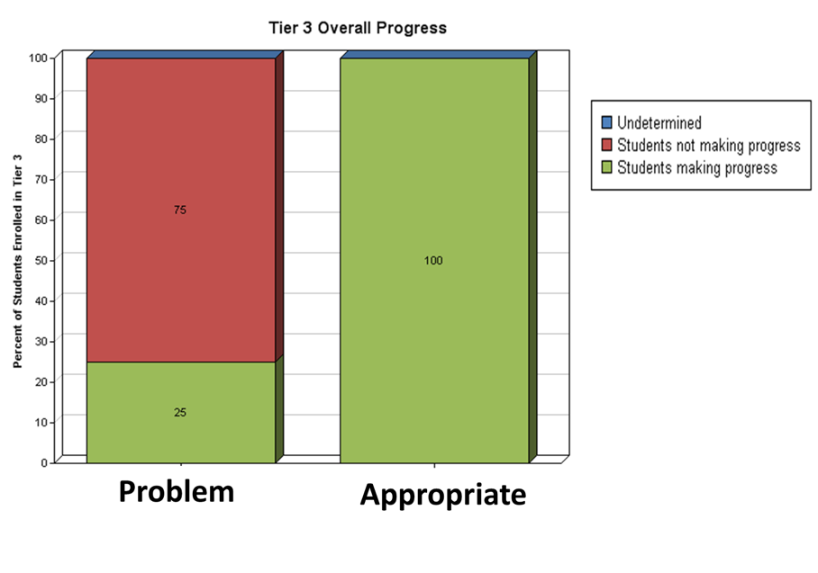
School-Wide
Notes:
School Wide

Slide 67
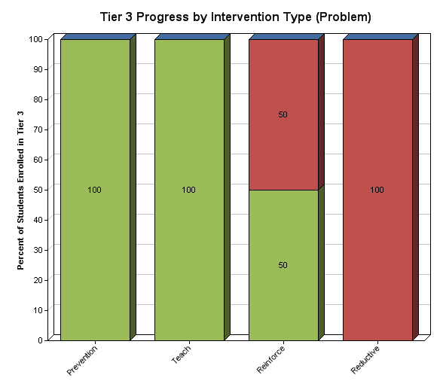

School-Wide
Notes:
School Wide

Slide 68
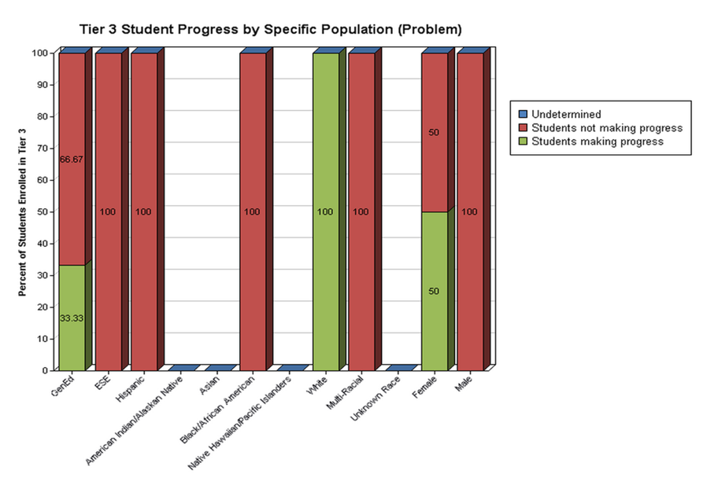

Slide 69
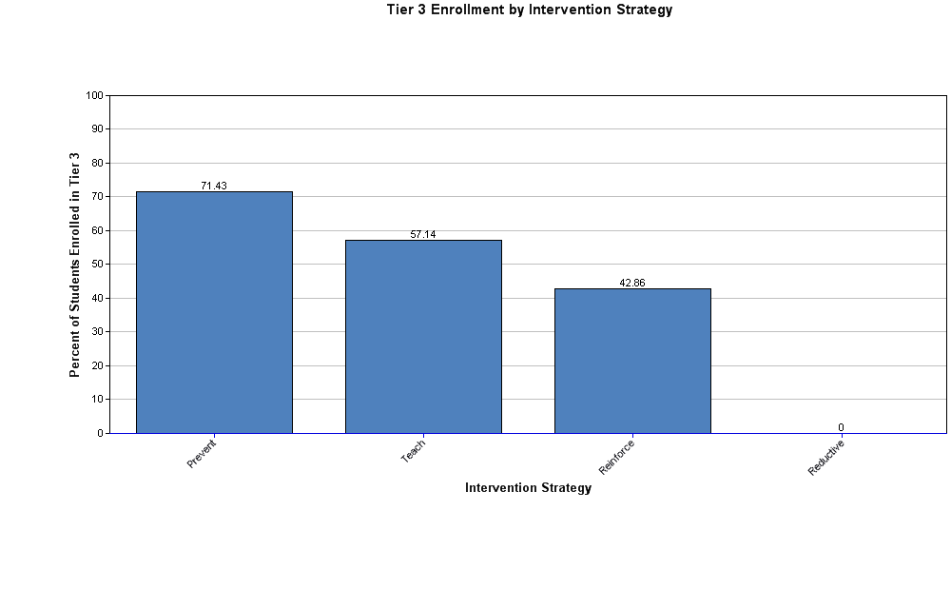

Slide 70
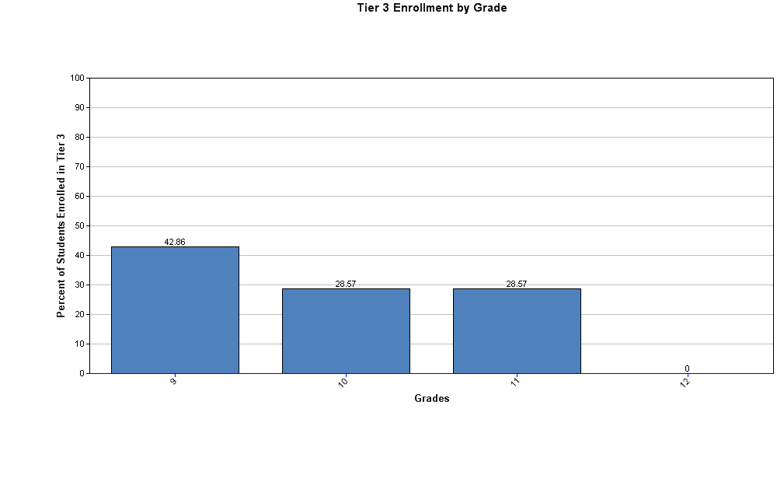

Slide 71
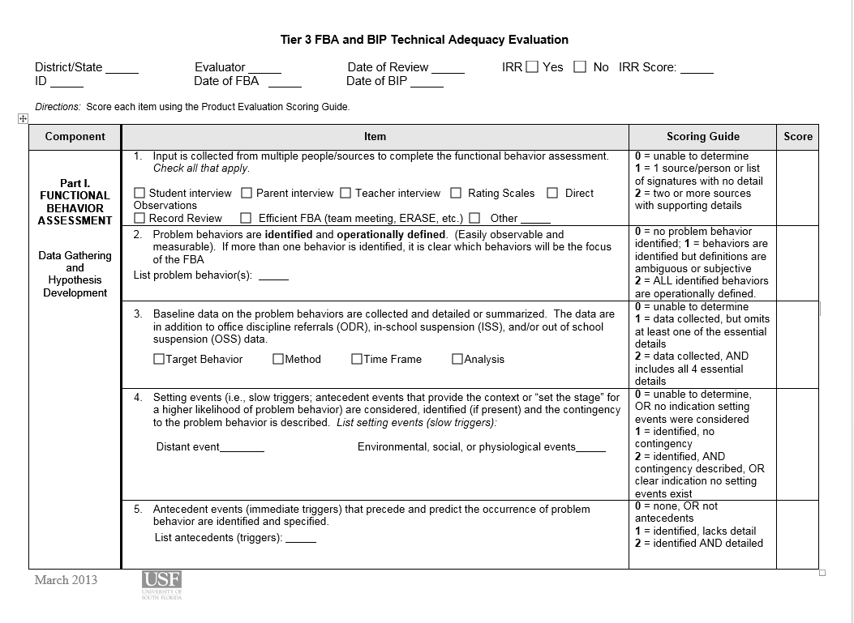
Evaluating FBA Technical Adequacy: First page of TATE

Slide 72
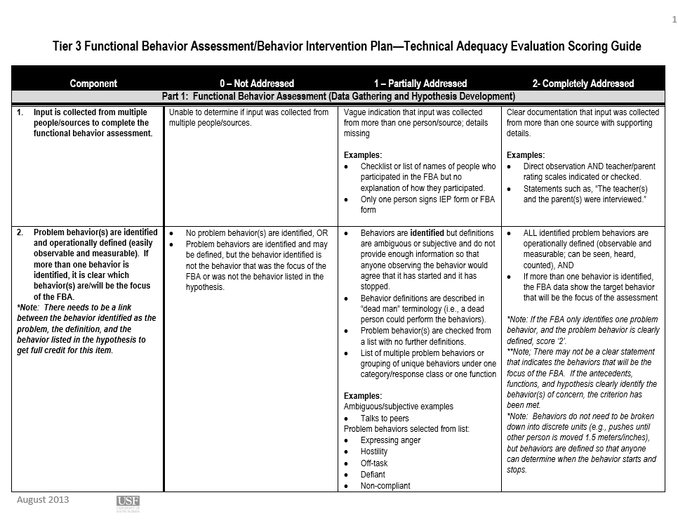
Sample: first page of scoring rubric

Slide 73
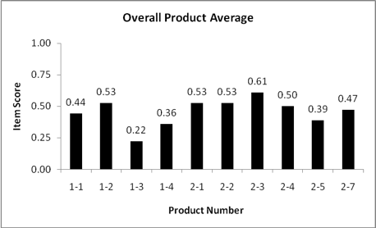
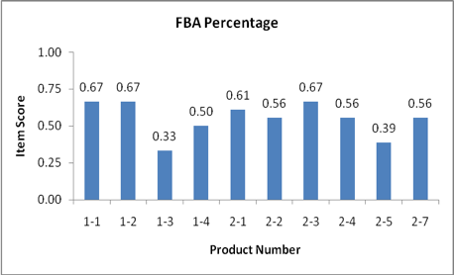
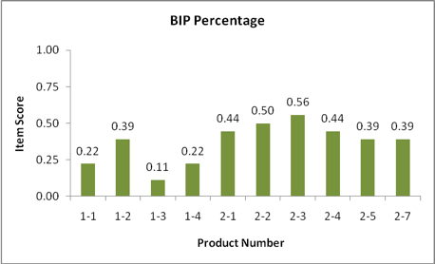
One District’s TATE Outcomes

Slide 74
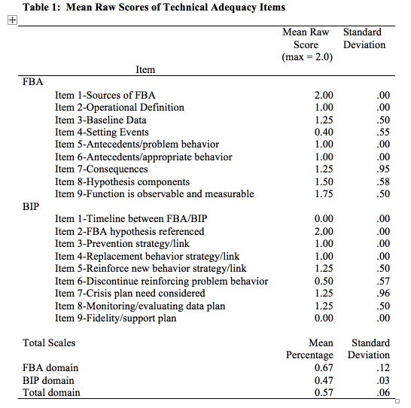

Slide 75
When to Evaluate Tier 3
District | School | Student
At least annually to assess fidelity, success and guide action planning. | Ideally, evaluation is part of monthly meeting process. | Evaluation is part of every meeting and meetings occur as frequently as necessary. Monthly monitoring or progress is a minimum. Weekly is preferred.
75

Slide 76
Challenges Facing Schools
Three-fold
  There is an absence of clear guidelines for developing a results-driven tier 3 system that is conceptually systematic yet practical and efficient for school application.
  There is a shortage of trained personnel who can implement the practices with fidelity
  There is a lack of ongoing supports provided to districts that will ensure implementation and sustainability of evidence-based processes that improve outcomes for all students with serious problem behaviors
Notes:
Second bullet-it should not be expected that all educators have the skills and experience in individualized behavioral interventions. Consider academics-it is not required for all educators to have expertise in providing intensive reading supports to student with the greatest needs.

Slide 77
What We Know About Tier 3 in Florida Schools (and probably others)
Source—Baseline assessments
  Most districts did not have a Tier 3 leadership team
  Process within district inconsistent (general vs. special education; quality contingent upon skills of people on campus)
  District training primarily consists of PPT presentations
  Practice-based coaching non-existent
  Lack of coherent, consistent process for identifying students needing Tier 3 supports
  Lack of fidelity measures (Tier 3 processes and intervention implementation fidelity)

Slide 78
What We Know About Tier 3 in Florida Schools
No systemic data system
FBA/BIPs have multiple problems including:
    Missing or non-functional baseline data
    Minimal detail about setting events and antecedents
    Missing consequences (i.e., actual responses of others following problem behavior)
    Link of hypothesis components to FBA assessment
    Missing linkage of interventions to hypothesis
    Description of interventions vague
    Over-reliance on consequential interventions
    Missing follow-up plans
    No plan for fidelity measurement

Slide 79
District-Wide Tier 3 Process
District-Level
Tier 3 process development and monitoring
Monitoring individual student progress (data collection and analysis)
FBA/BIP development and training
Professional development
School-Level
Referral process for students needing Tier 3 supports
Timeline for students accessing Tier 3 supports
FBA/BIP development and implementation
Coaching/training and on-going teacher support
Monitoring student progress
Criteria (decision points) for increasing or decreasing levels of support
Fidelity of implementation

Slide 80
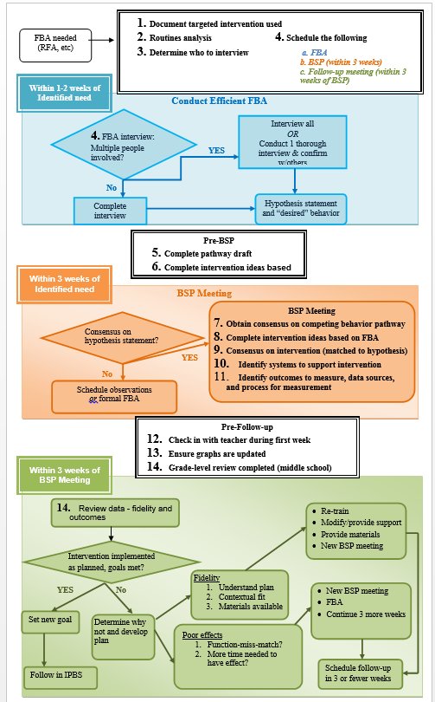
Example of a Consistent Tier 3 Process

Slide 81
Considerations for Additional Expertise
To have an effective tier 3 system, districts will have a coherent process for determining when and how to obtain additional supports and expertise
General guidelines for developing a plan:
  Identify situations in which there is a need for additional expertise
  Identify skills or specific expertise required
  Describe methods/process for accessing additional expertise
  Develop procedures for coordinating and collaborating with internal and/or external professions
    Procedures include integration of activities within the continuum of school-based behavioral support
Develop guidelines for requesting more in-depth functional assessment procedures
  Note: FBA/BIP process is a foundation; however, the FBA/BIP process may look different for individuals who present with behaviors that are internalizing or characteristics of conditions (e.g., anxiety, depression)

Slide 82
Examples Of Conditions Or Behaviors That May Require Additional, Expertise.
Intense Behavioral Problems | Psychological/Mental Health | Medical | Life Situations
Extreme self-injurious behavior endangering health/well-being Intensive physical aggression acts toward peers and/or adults and/or property causing bodily harm or significant property destruction Behavioral problems are so intense and resistant to interventions and student is at risk for more segregated placements and/or being incarcerated | Suicidal ideation and/or suicidal attempts Engaging in seriously threatening behaviors that are unlawful and may result in incarceration Personality and/or psychotic disorders High risk sexual behavior Post-traumatic stress Significant substance abuse related disorders (e.g., alcohol, drug) | Psychosomatic illnesses (e.g., extreme headaches or stomach problems due to stress) that contribute to or exacerbate internalizing or externalizing Sleep disorders Frontal lobe damage Seizure disorders Enuresis Encopresis | Homelessness Food deprivation Traumatic situations (e.g., abuse-sexual, physical, psychological Exposure to savage acts (e.g., war, murder, rape) Extreme poverty Foster care placements and/or unstable home placement
*Note some of these example may fall under multiple domains (e.g., encopresis may involve behavioral health and/or medical intervention)

Slide 83
Summary
We need to begin to consider Tier 3 as a system
We have tools and protocols allow us to assist districts and schools to deliver more consistent and effective Tier 3 supports.
Finally, this is a long-term process requiring commitment!

Slide 84



Contact Information and Resources
FLPBIS:MTSS Project
  Phone: (813) 974-7684
  E-mail: flpbis@cbcs.usf.edu
  www.flpbis.org
  www.facebook.com/flpbs
  https://twitter.com/flpbis
  https://www.youtube.com/user/flpbs1
OSEP TA Center on PBIS Association on PBIS
  www.pbis.org www.apbs.org
Notes:
May want to share a video here of Rita Pierson’s TED Talk as a wrap up
(fixed 12/8/17)

Slide 85

Notes:
http://bit.ly/NF20-j3

