Slide 1
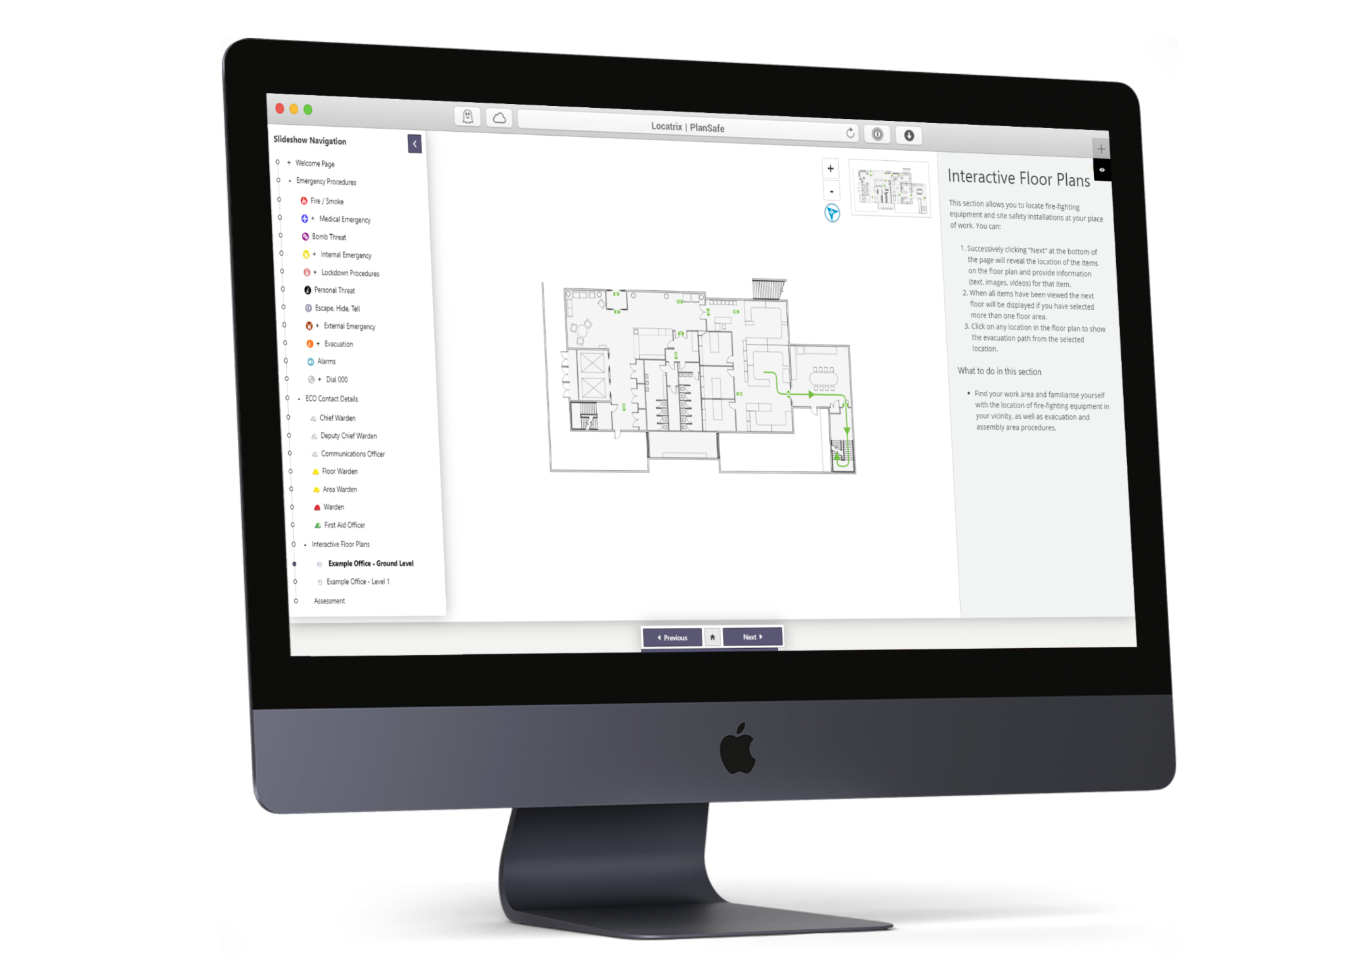

PlanSafe
Online Safety Induction and Emergency Management Plan
Our Software Saves Lives
Notes:
Introduce yourself and your role….
SAY: In this presentation , I am going to describe to you where I came from, the work we do, and more importantly our product PlanSafe and how you can be apart of this. I am going to discuss the features and benefits with a quick demonstration at the end.
SAY: We believe that if you are able to give the information pertinent to the inside of a building to first responders in a timely fashion with a digital foot print you will save lives. Its that simple. If you can provide clearly defined map of the fire installation points and the information contained in a fire and evacuation emergency plan to emergency services, this critical information will save them time which in turn saves lives. That is what Locatrix software does.

Slide 2
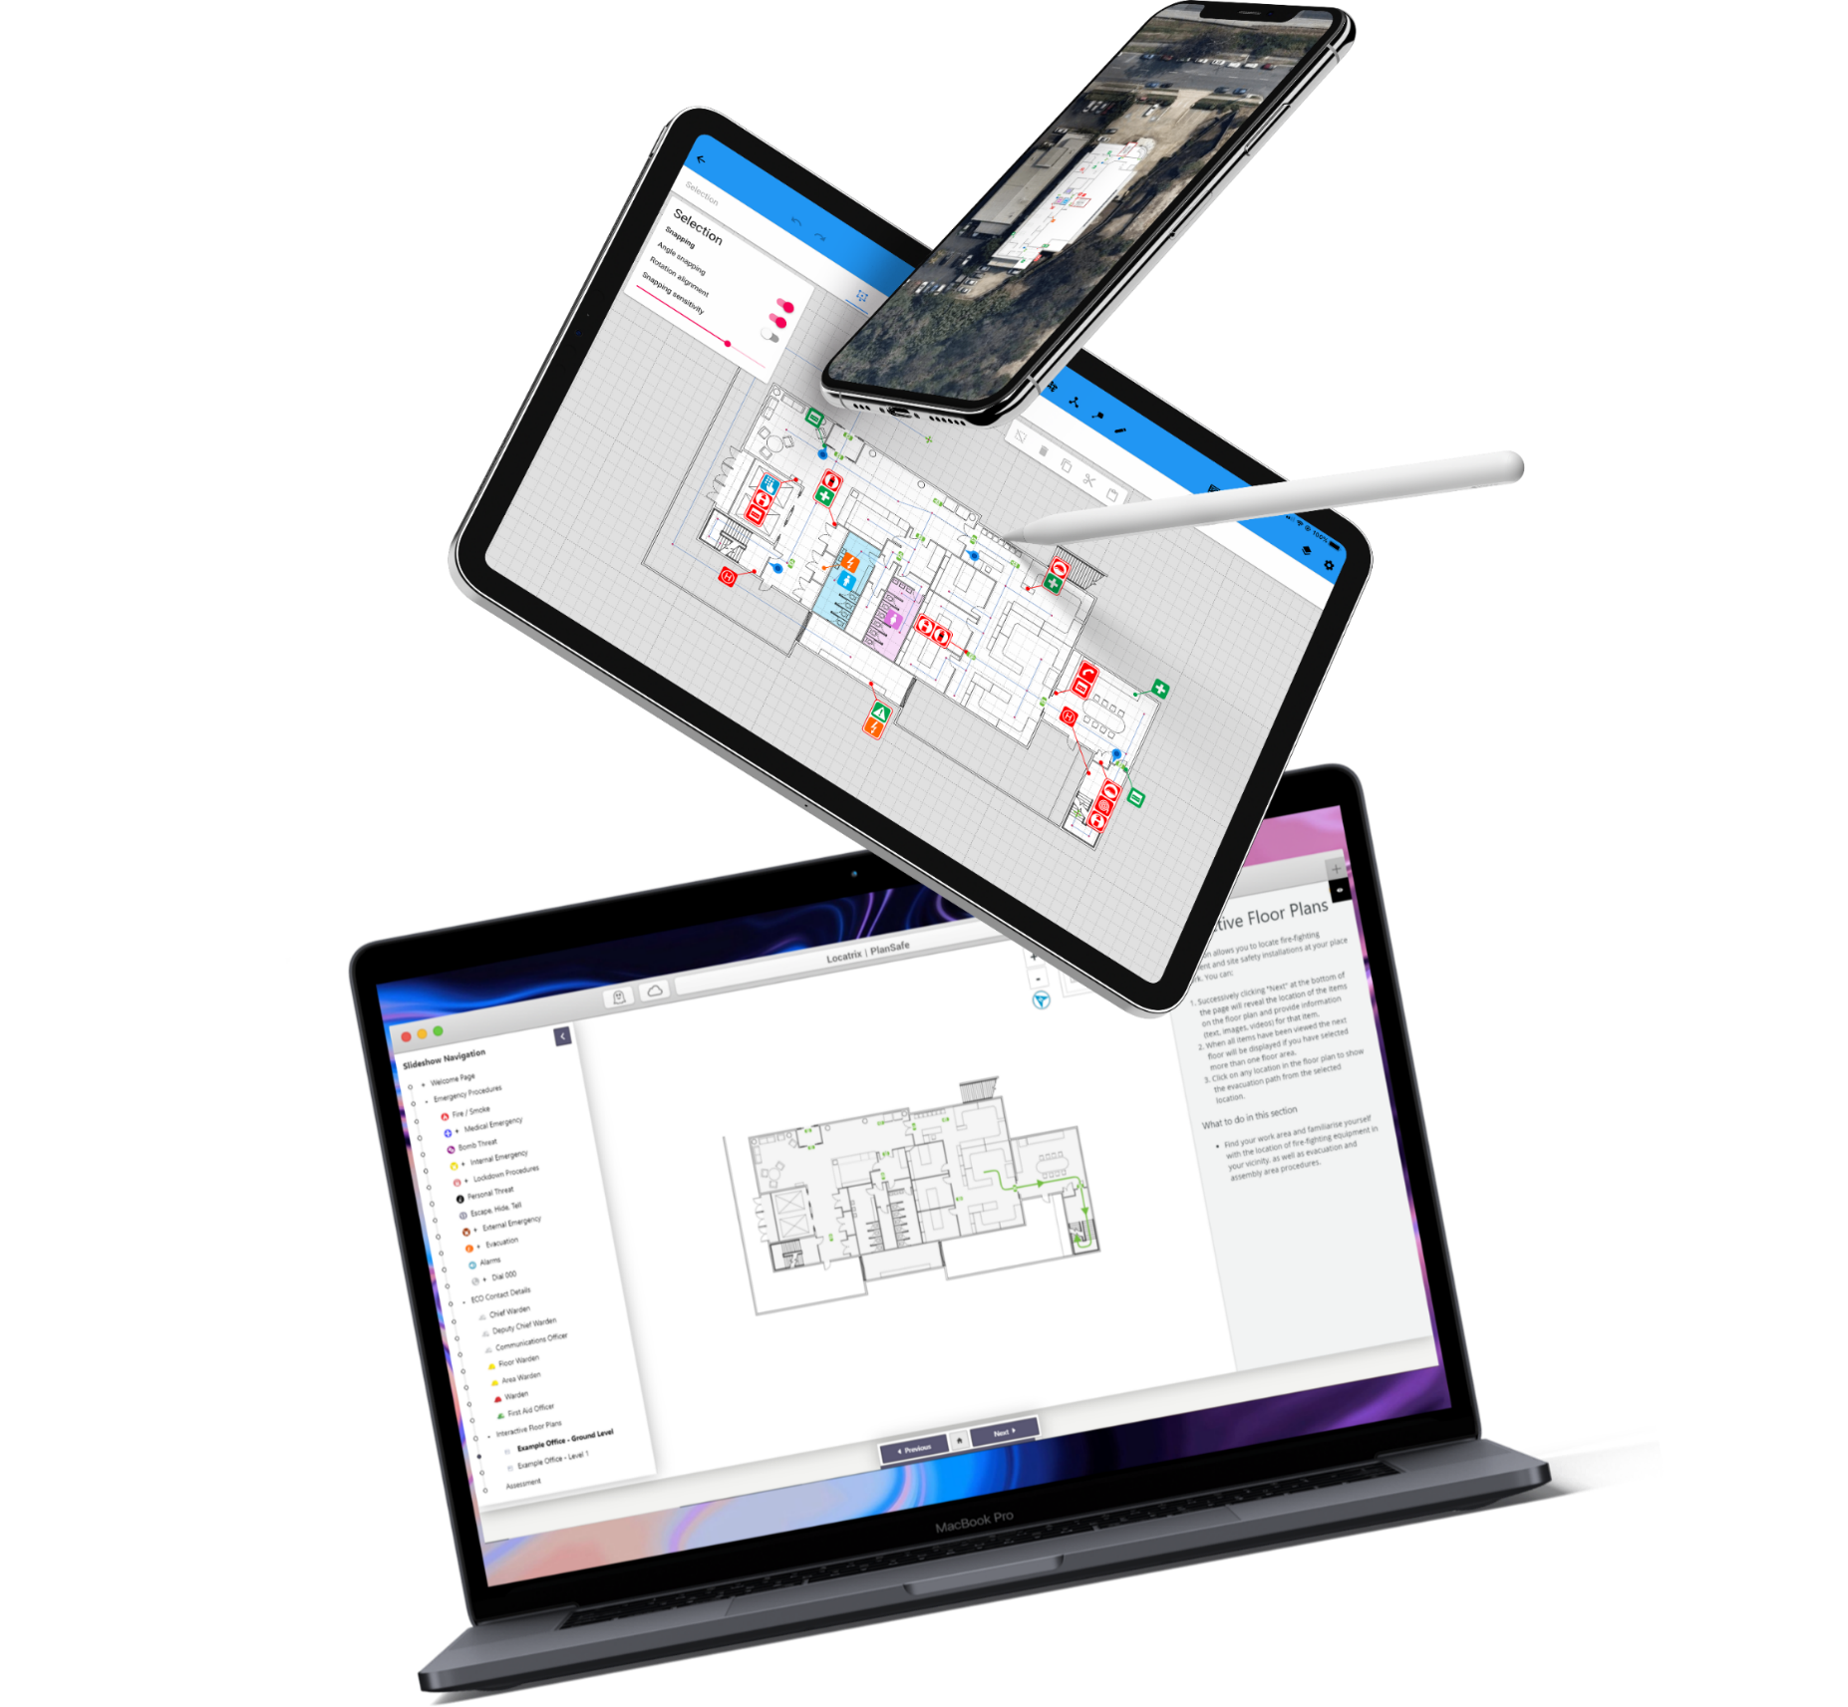
Content Outline
Introduction
Our Background
Features & Benefits
SQM Pricing Model
Our Courses
Testimonials
Client Success Stories
INSERT YOUR LOGO HERE
Notes:
NOTE TO PARTNER: This is the introduction slide for the sales presentation outline content page.

Slide 3

Our Background
A simple timeline on how your partner led strategy came to be is a helpful way of visualise your company story.
Company Name
Step 1
Insert Year
Write your company name above and a summary of what your company does here.
Step 2
Insert Year
Step 3
Insert Year
YOUR LOGO HERE
Notes:
NOTE TO PARTNER: Introduce the background and company here with a simple timeline of how you came about.

Slide 4







Feature and Benefits
Branding
Elements
Add your own company’s logo colour scheme and dashboard banners. Training looks and feels like its being delivered by your company.
Secure and
Private
PlanSafe is certified to ISO 27001 standard. All your building’s information and training records are kept secure and private. This ensures the safety of your information and your businesses reputation.
Interactive
Floorplan
Interactive plans displaying evacuation paths and reference points saves costs by removing the need to engage a trainer to conduct a physical walkthrough of the building.
First
Responders
Your building’s digital Emergency Management Plan (EMP) is shared with first responders to improve the safety of people within your building.
Automated Emergency Management Plan
If any changes are made to your training content in PlanSafe, these are automatically reflected in your emergency management plan document, saving you time and money.
Site Specific
Online Training
Your staff complete online training that is relevant to their own building. This avoids time spent learning information irrelevant to their building.
Integrated with Other Platforms
PlanSafe integrates with your existing learning platform through SCORM or API providing the simplicity of keeping your training records in one location.
Stay
Compliant
Legislative updates are included to ensure your buildings are always compliant to the Australian Standards avoiding penalties and fines.
YOUR LOGO HERE
Notes:
NOTE: Discuss the key features and benefits of PlanSafe
Key Points:
Brand customisation - adding your own logo and client branding – easy to reflect your company’s identity.
Security is of top priority - with the highest ISO 27001 standard. The buildings information and training records kept private and secure. IP remains with the client and locatrix owns the software, content can only be shared with emergency services to safe lives.
Interactive floor plan – displays all the evacuation paths and reference points saving the cost by removing the need to engage a trainer to walk through a building.
First responders - have access to critical information for your building to ensure the safety of people with the building.
Automated emergency management plan – seamlessly update changes to your emergency management plan.
Site Specific online training – relevant to your own building saving you time learning irreverent information as well as general, evacuation and first response instruction training and warden training.
Integrate with other LMS platforms, with SCORM or API so all training records are in one location.
All of which is compliant and kept current to legislative and Australian Standard updates.
Some other key features and benefits are warden management, automated email notifications, able to track compliance training for regulatory and auditing purposes.

Slide 5


How to calculate the
SQM pricing model?
Example Calculation
$1000
1000m² x $1.00 =
$83.33 per month
$1.00
per SQM per annum
YOUR LOGO HERE
Notes:
NOTE for the Partner: Use this slide to help the client work out how to calculate the square metre model, potentially using their building to calculate.
This is an example for you to use only
If you 1000m2 x $1.00 = $1000
$83.33 per month or you may want to charge the client the total fee up front or give them the option.
We recommend $1 a square metre
Block Plans approximately $1000
F&E Plan approximately $1000
Evacuation Signs approximately $100

Slide 6



Our Courses
General Evacuation /First Response Training
Equips the building occupants with the skills and knowledge to prevent and respond to an emergency situation in your workplace.
Introduction to fire extinguishers and appropriate equipment to use in the event of an emergency.
Site Specific Induction.
ECO (Emergency Control Organisation) Training
How to operate as part of an emergency control organisation.
To enable Wardens to carry out their duties in an emergency.
Compliant with Australian Standards
AS 3745-2010: Planning for emergencies in facilities
AS 4083-2010: Planning for emergencies in healthcare
QLD BFSR-2008: Building Fire Safety Regulation
WHS/OHS : The emergency plan including Site Induction
Duration 15 – 20 Min | Location PlanSafe online learning | Certification A statement of online completion
YOUR LOGO HERE
Notes:
NOTE TO PARTNER: Use this slide to discuss the two online courses offered on PlanSafe.
SAY: What do we offer? We offer two online courses, General Evacuation and First Response Training which includes first fire attack firefighting equipment training and ECO Training on how they operate as part of the ECO, all of which is compliant with Australian Standards. These courses are 15-20 minutes long per training and once completion of the online assessment a record and statement of online completion is recorded for the learner for that specific building.

Slide 7


Testimonial
“We were finding it difficult and costly to maintain fire and emergency instruction compliance across our 82 buildings.
With the added complication of inducting shift workers, agency staff and staff with English as their second language, PlanSafe could provide these learners an opportunity to be inducted anytime, anywhere – a convenience that face-to-face training doesn’t offer.”
Gordon Cunningham
Manager Work Health and Safety
Wesley Mission Queensland
Notes:
NOTE TO PARTNER: Use this testimonial and swap out relevance to presentation of the company.

Slide 8


Testimonial
“More than 1000 people completed the online fire training the first week the program went live and more than 3,000 staff by the time the
Lady Cilento Children’s hospital opened.
The web-based program was easy to access and any changes within the new building were readily incorporated within the system to enable ‘real time’ learning. Overall, the system provided an efficient and effective solution to manage the significant fire and evacuation training requirements of our new hospital.”
Karen Davies
Director, Safety and Wellbeing, Children’s Health Queensland
Notes:
NOTE TO PARTNER: Use this testimonial and swap out relevance to presentation of the company.

Slide 9


Testimonial
“PlanSafe gave us the ability to induct all of our employees, contractors, members and visitors with the skills and knowledge to remain safe at our racecourses. This would not be possible without the turnkey capabilities of this system”
Kim Elliott
Asset and Facilities Manager,
Tas Racing Pty Ltd
Notes:
NOTE TO PARTNER: Use this testimonial and swap out relevance to presentation of the company.

Slide 10


Client Success Story
A solution was developed for State Government Agencies that raises the bar in legal compliance and elevates safety awareness and safety management for employees and contractors.
The interactive floor plans were created for each site and building to provide localised information on any form of equipment at each location and videos customised to the Government’s requirements.
Queensland Government
State Government Agency
Notes:
NOTE TO PARTNER: Use this testimonial and swap out relevance to presentation of the company.

Slide 11


Client Success Story
Suncorp adopted PlanSafe's online safety induction and emergency management program to provide safety information and safety training to their employees and wardens through a single system that enabled them to achieve 100% compliance with the current WHS/OHS Legislation, the Building Fire Safety Regulation 2008 and Australian Standard (AS 3745-2010).
Suncorp Group Limited
Banking Corporation
Notes:
NOTE TO PARTNER: Use this testimonial and swap out relevance to presentation of the company.

Slide 12


Lets Begin!
How about a
Demonstration?
Notes:
NOTE TO PARTNER: This is where you can go into a PlanSafe demonstration to the company

Slide 13



Contact Us
Your Name
123-456-7890
Your Job Title
Department
yourname@company.com
www.yourwebsite.com
Notes:
NOTE : Add your contact details or business card details to this slide.

