Slide 1


Slide 2
Burn & Scar awareness camping 2023
Prepared by/ Khairia Othman

Slide 3
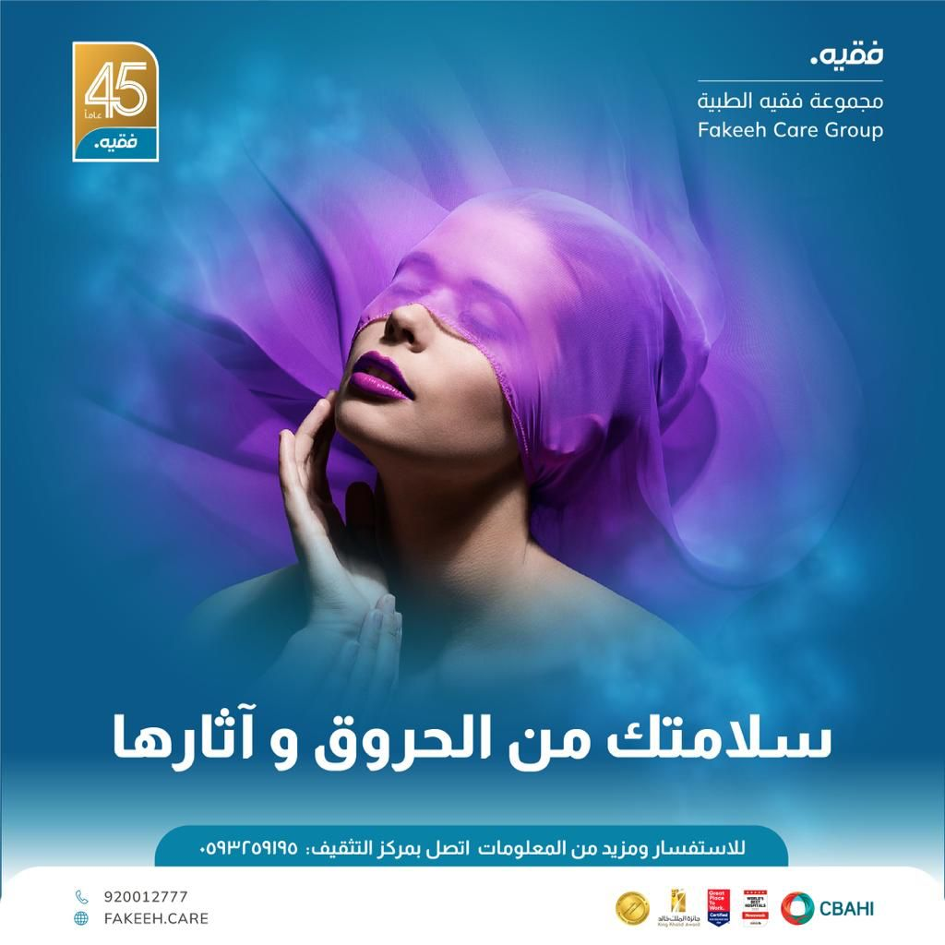
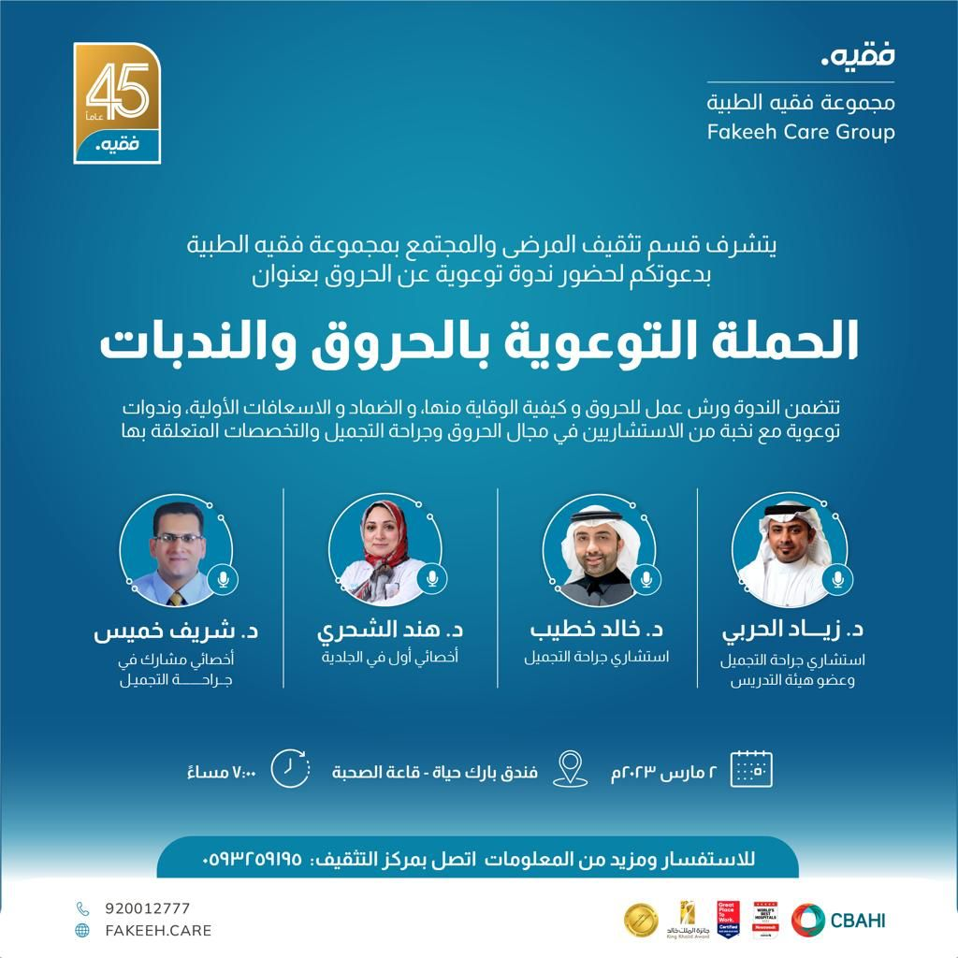

Slide 4
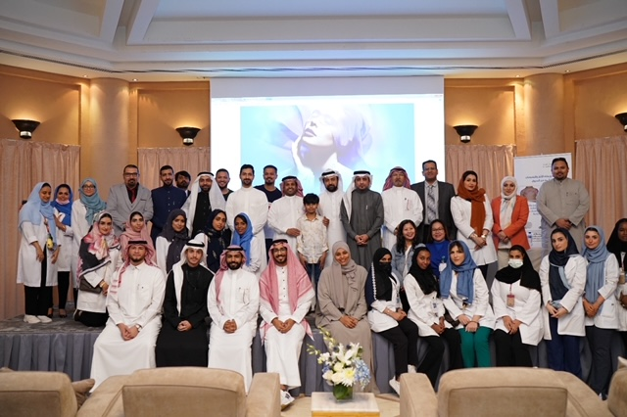

Slide 5
Venue: Park Haya hotel.
Date and time: March 2, 2023
Target audience: for Public
Speakers:
Dr. Ziyad AlHarbi (consultant plastic surgery & Faculty member).
Dr. Khalid Khateeb (consultant plastic surgery)
Dr. Hind Alshehery (senior specialist dermatology)
Dr. sheriff Khamis (senior associate specialist in Plastic Surgery)

Slide 6
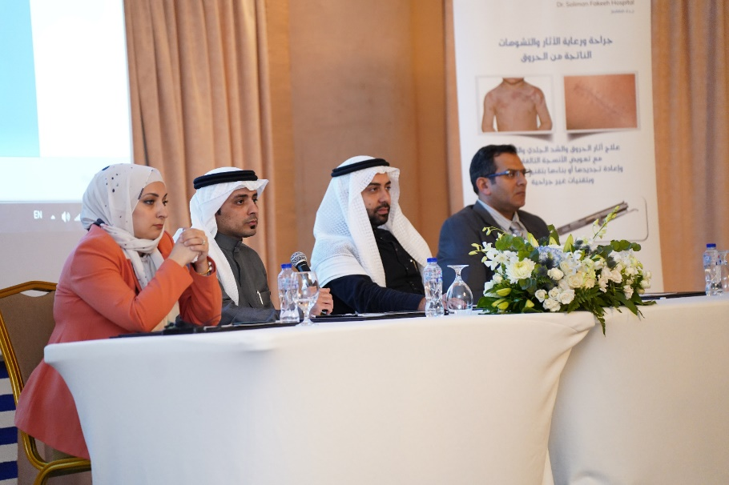
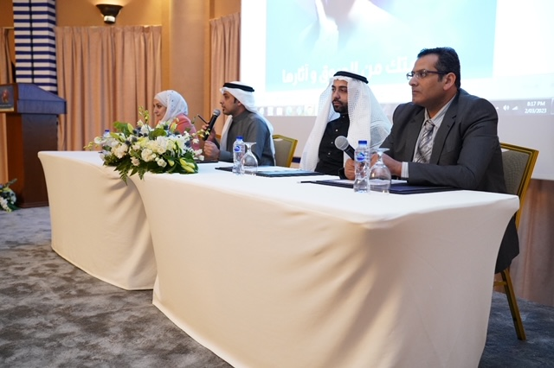
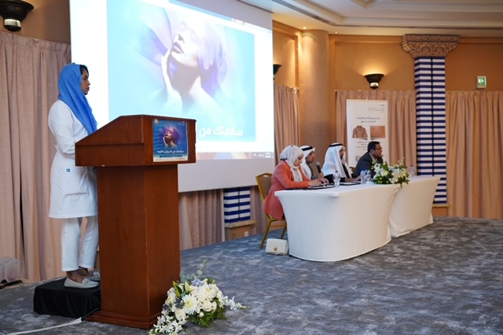

Slide 7
Event report:
The campaign dealt with two parts:
- workshop & educational booths which was educating the audience about the burn stages and the treatment of each one, first aid, wound care and home health care services.
- Open discussion with speakers from different specialties who were interacting with the attendees and answer their questions.

Slide 8
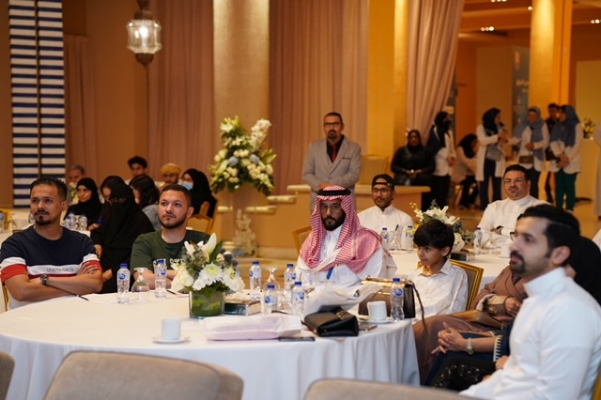
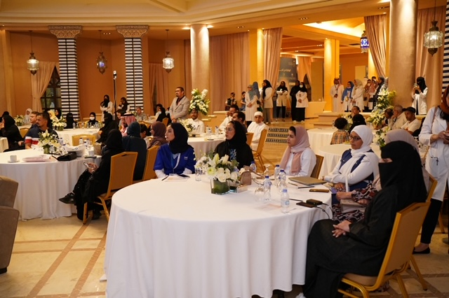

Slide 9
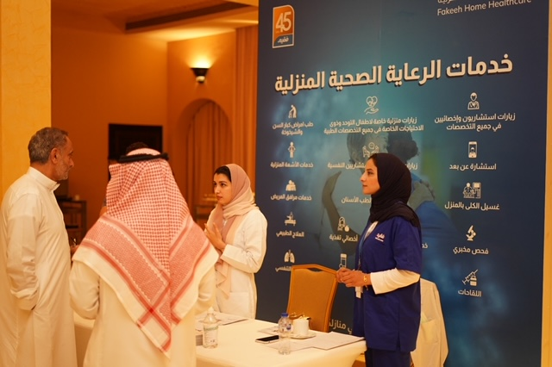
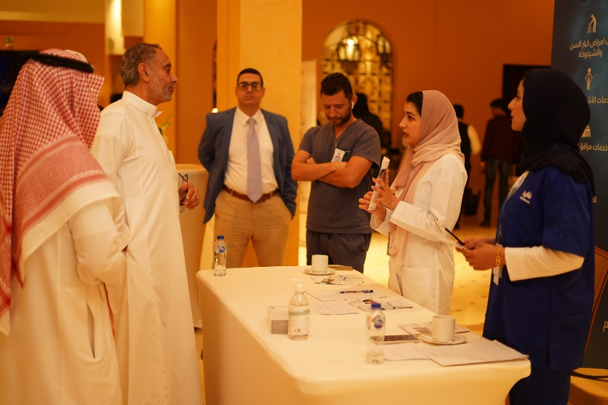
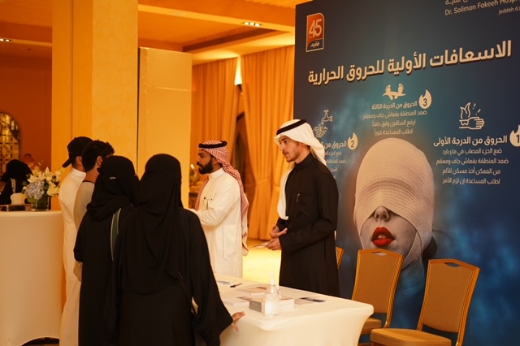

Slide 10
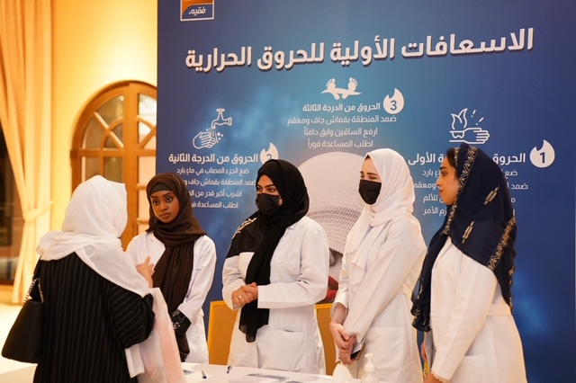
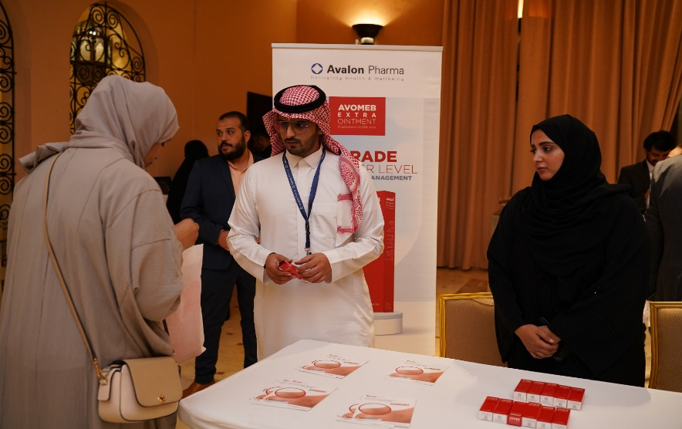

Slide 11
Event report:
Number of attendees: more than 50 person
As per the results of the survey that has been done:
- The attendees were satisfied with:
* the timing and place of the event by 95%.
* the topics raised by 100%.
- They have some suggestions about the days and the times of upcoming campaigns that will be taken into consideration.

Slide 12
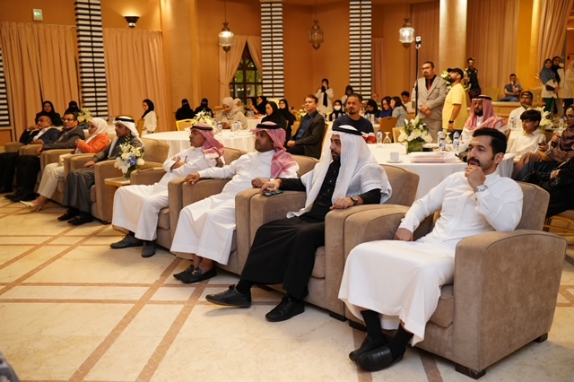
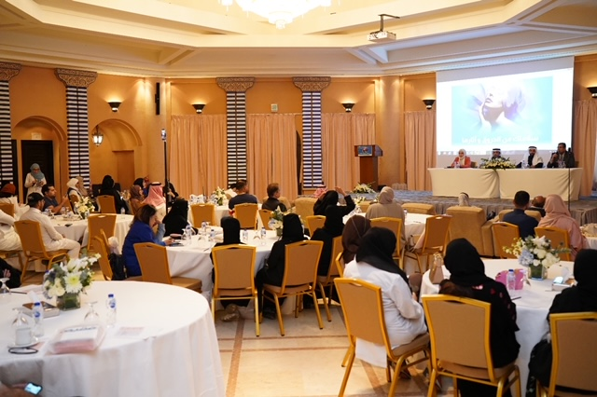
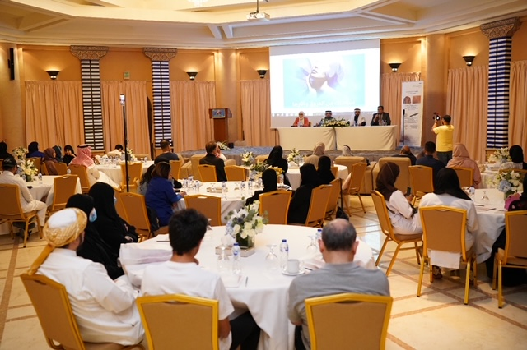

Slide 13
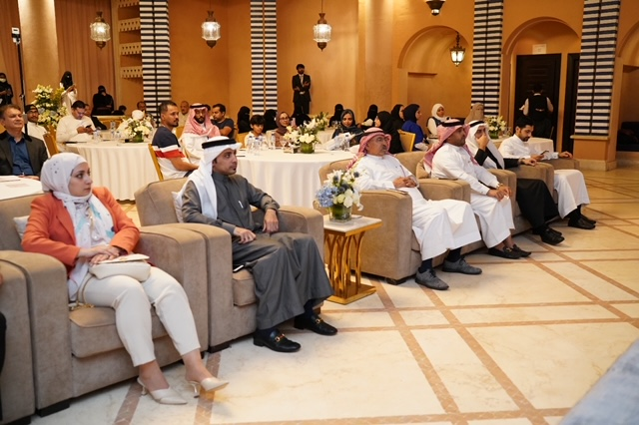
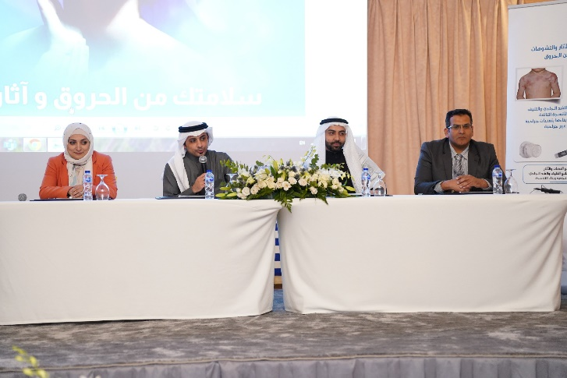

Slide 14
By the end of the event:
- Giveaways for the attendees were distributed.
- Honoring the participants & speakers.

Slide 15
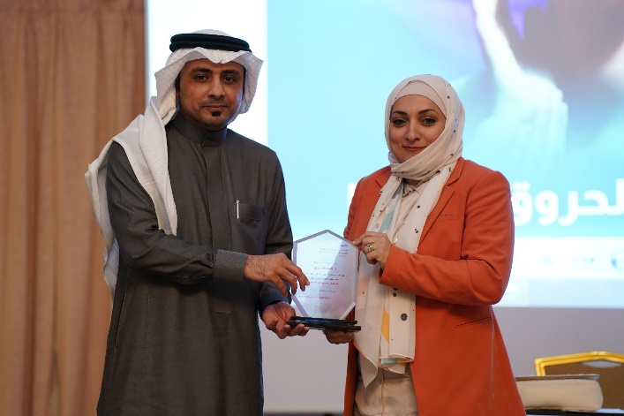
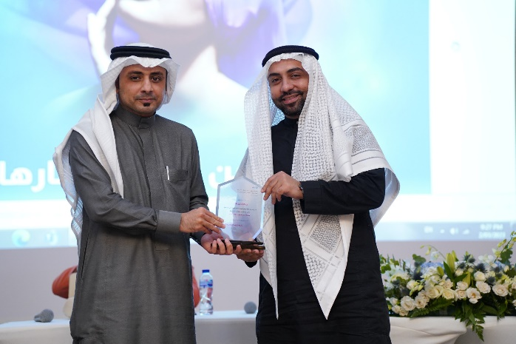
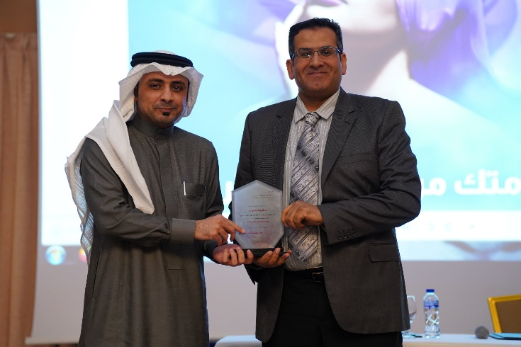

Slide 16
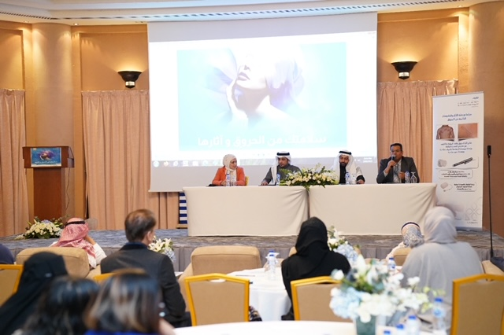

Slide 18


